Slide 1
Application Delivery Fundamentals 2.0 B: Java
Domain Driven Design

Slide 2
API Design
Goals
What is Domain Driven Design
The Challenges of Creating Software for Complex Problem Domains
How the Patterns of Domain‐Driven Design Manage Complexity
The Practices and Principles of Domain‐Driven Design
Popular Misconceptions of Domain‐Driven Design

Slide 3
API Design
Goals
Knowledge Crunching and Collaboration
Gaining Domain Insight with Domain Experts
Patterns for Effective Knowledge Crunching
What Is a Domain Model?
Model‐Driven Design
Using a Ubiquitous Language to Bind the Analysis to the Code Model

Slide 4
API Design
Goals
Collaborating on a Ubiquitous Language
The Domain Layer
Maintaining The Integrity Of Domain Models With Bounded Contexts
Context Mapping
Application Architecture
Applying The Principles, Pra Ctices, And Patterns Of DDD

Slide 5
API Design
Goals
Entities
Domain Services
Domain Events
Aggregates

Slide 6
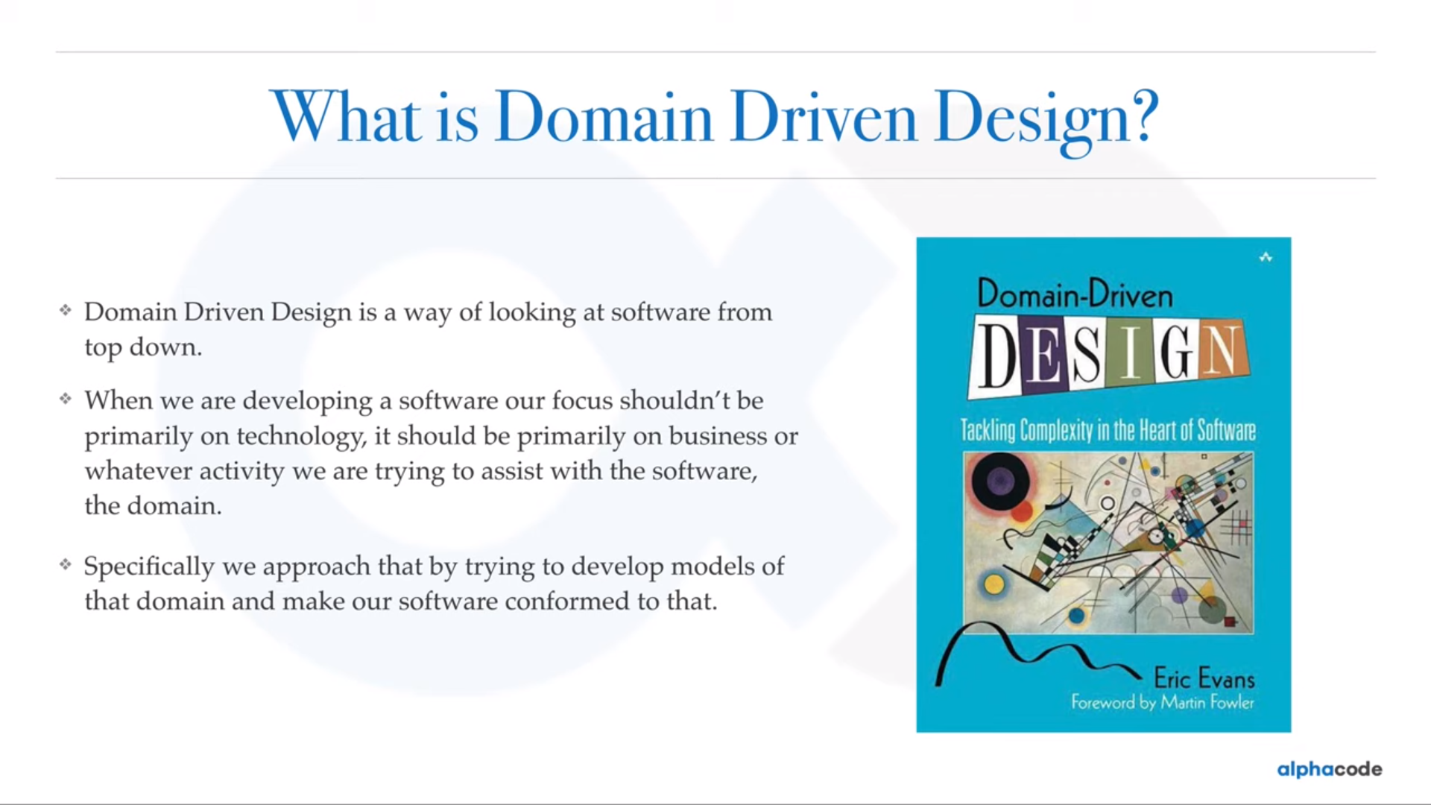

Slide 7
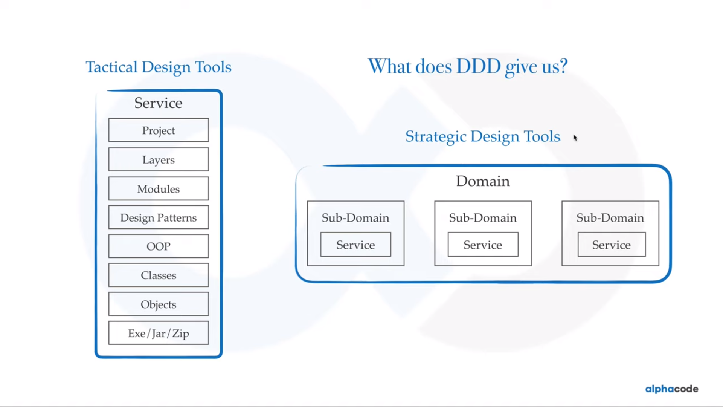

Slide 8
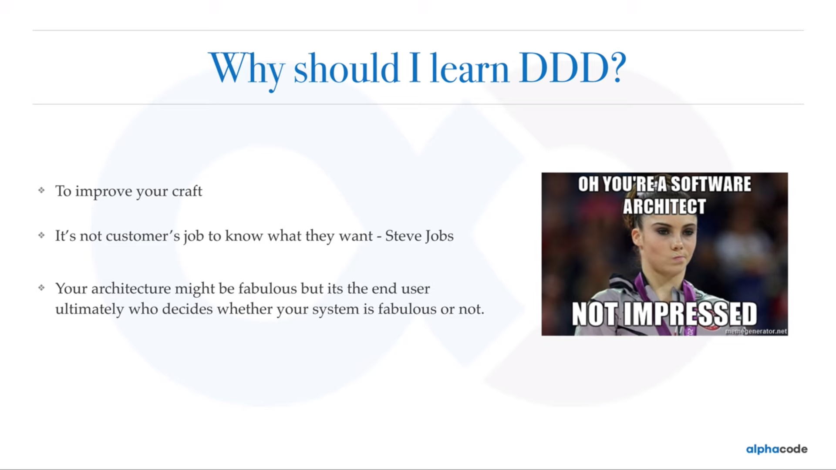

Slide 9
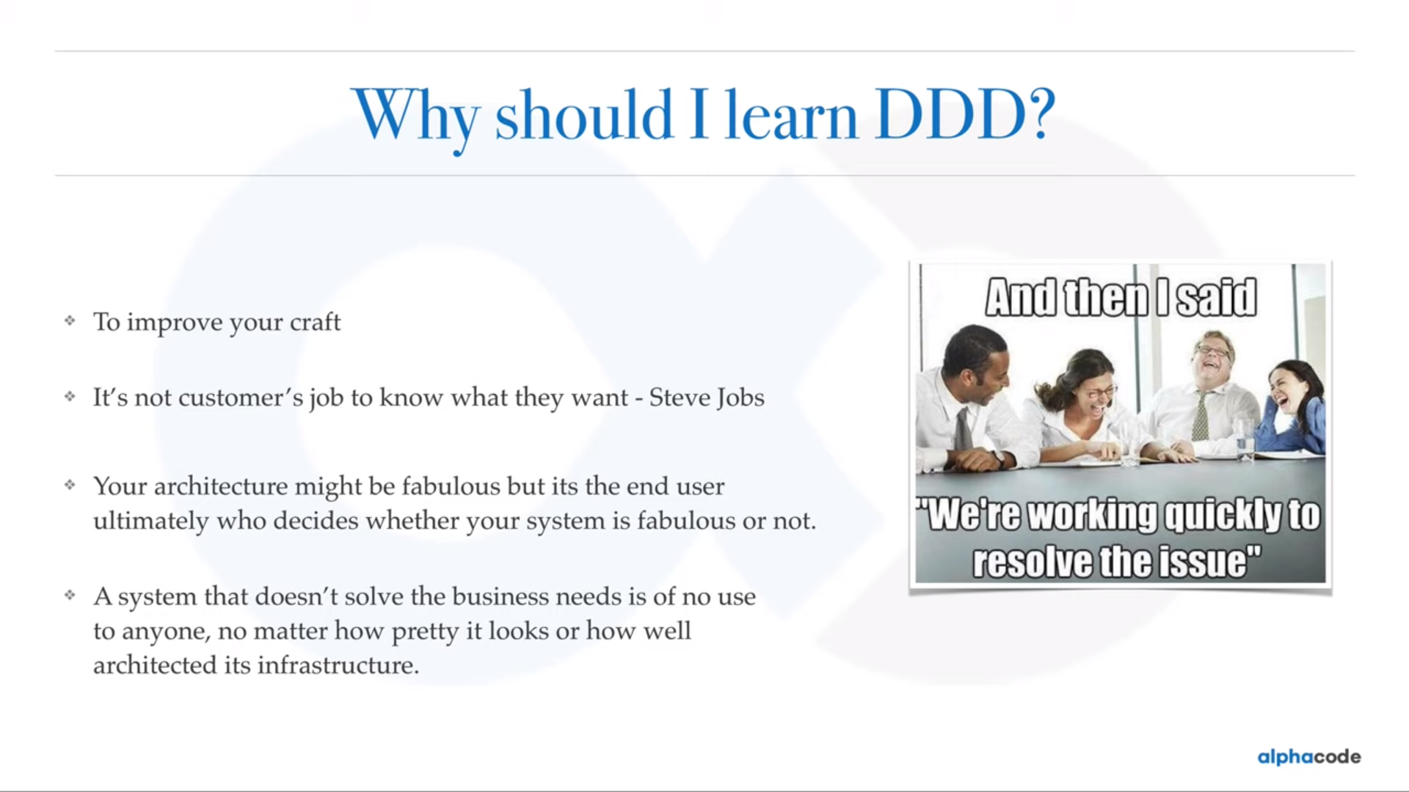

Slide 10
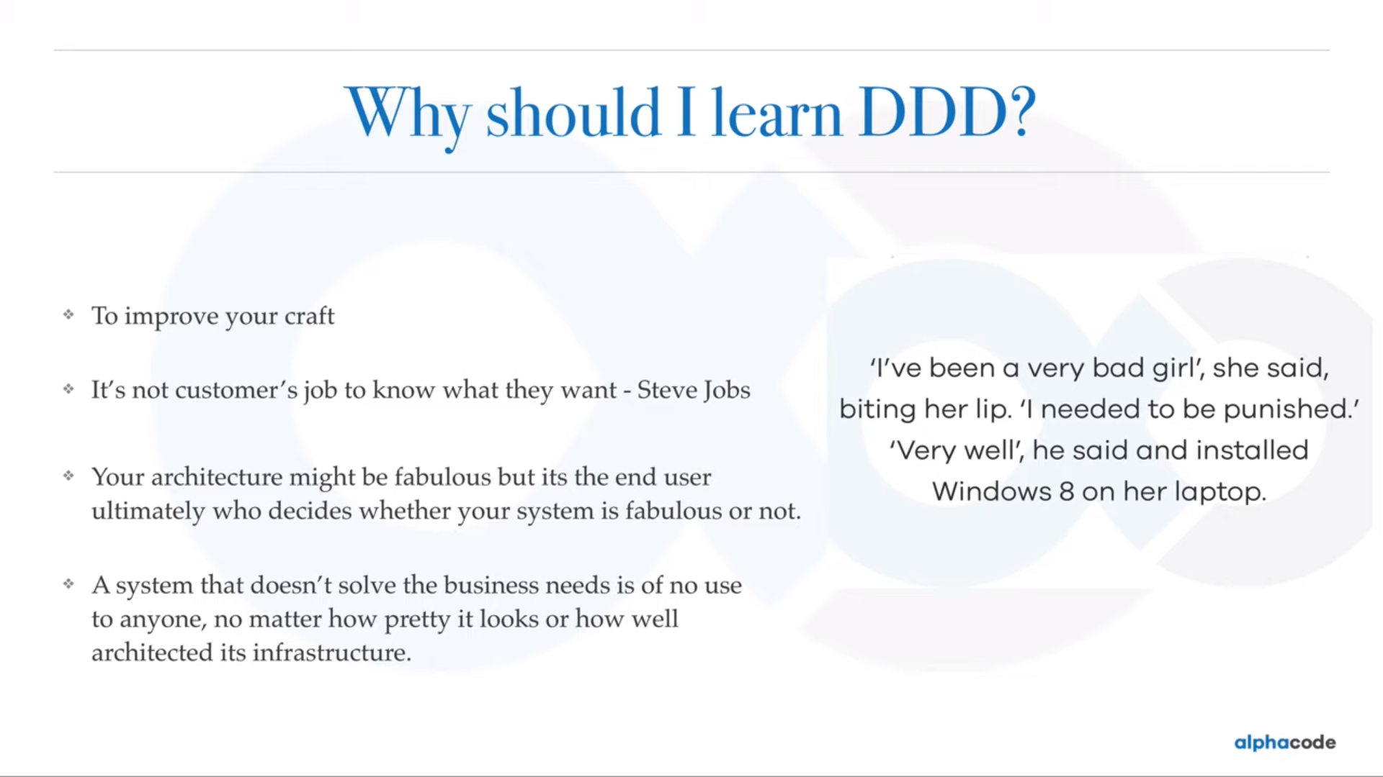

Slide 11
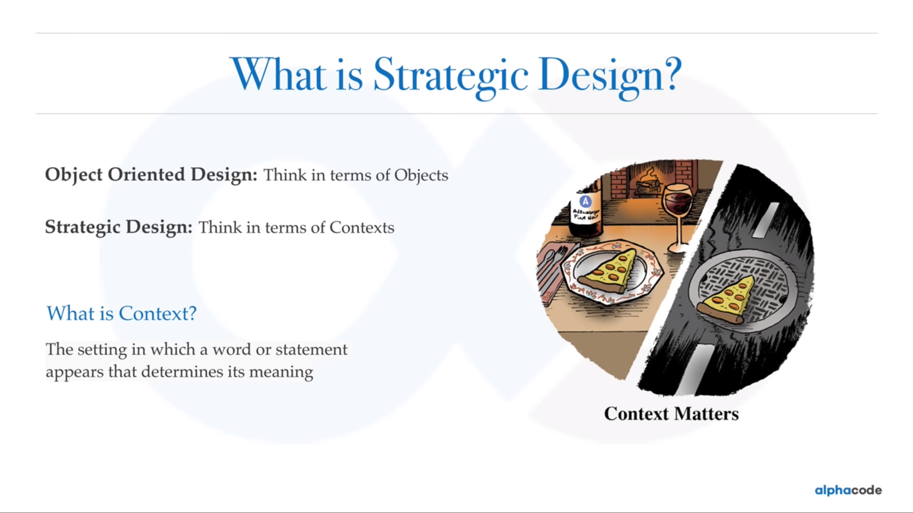

Slide 12
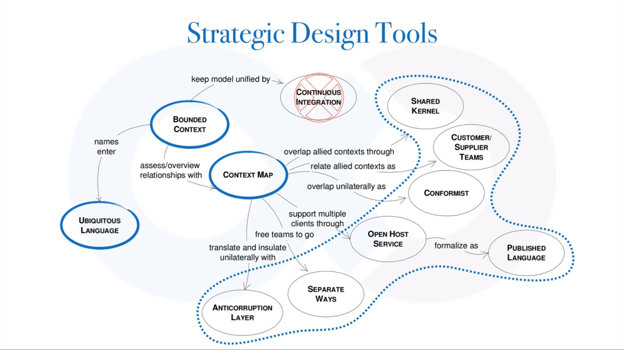

Slide 13
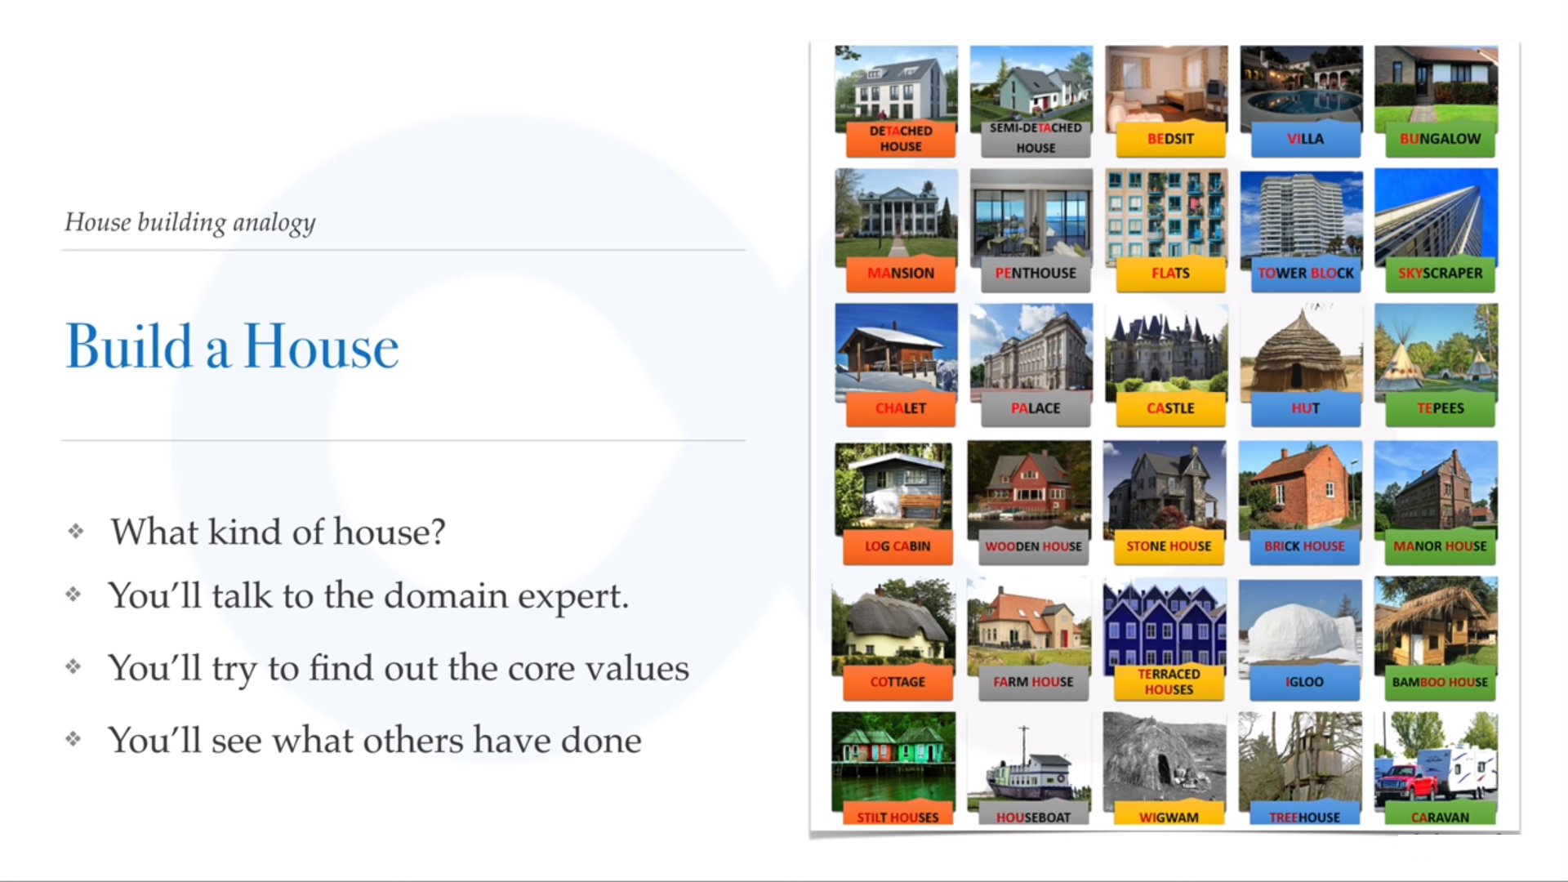

Slide 14
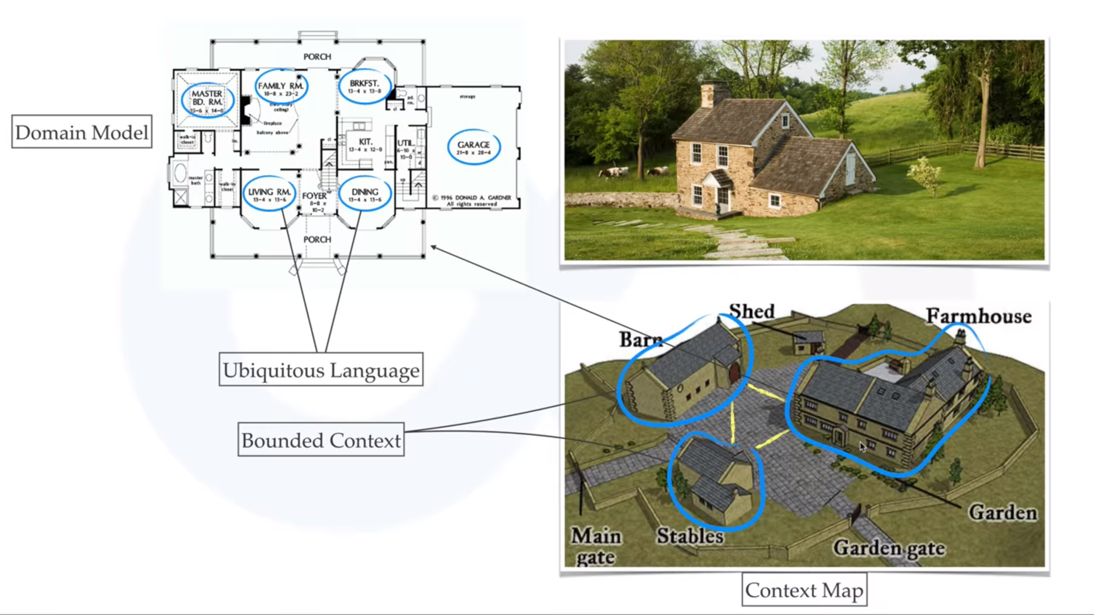

Slide 15
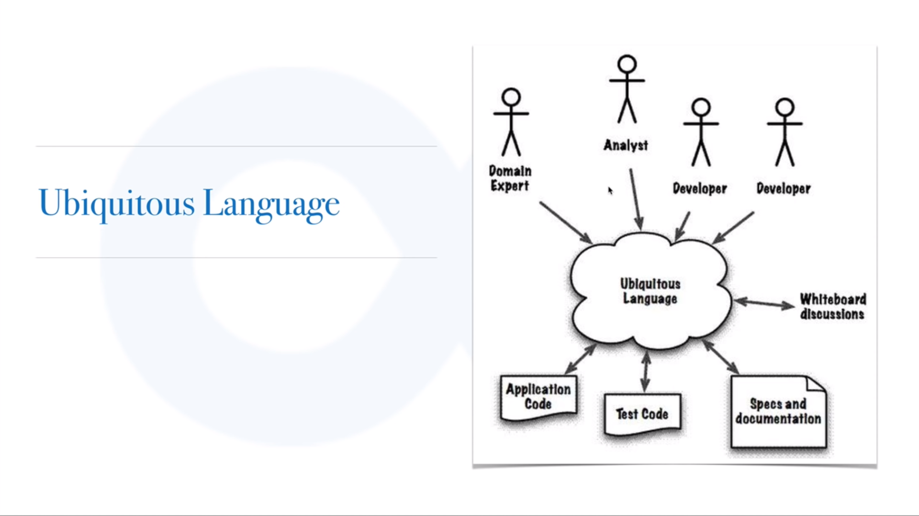

Slide 16
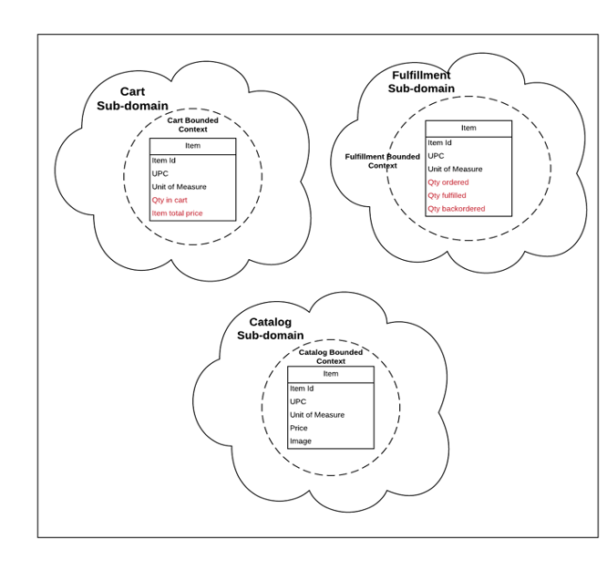
Domain and Sub Domain

Slide 17
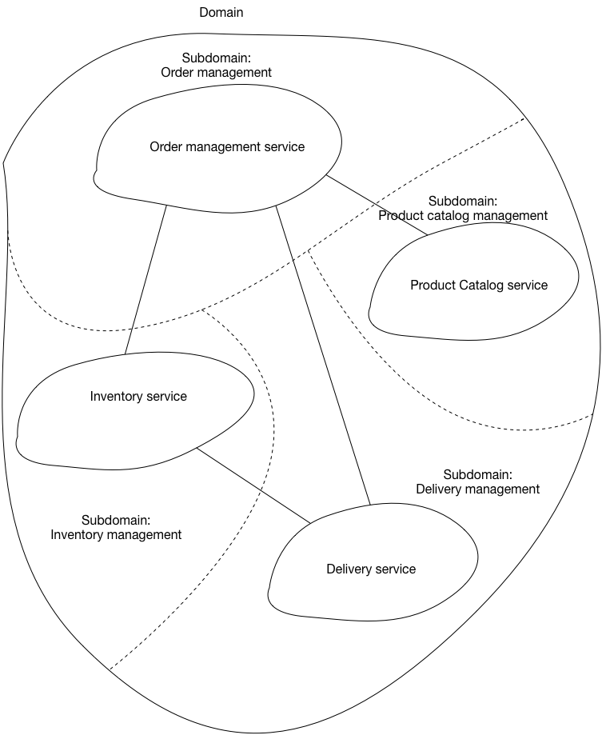
Domain and Sub Domain

Slide 18
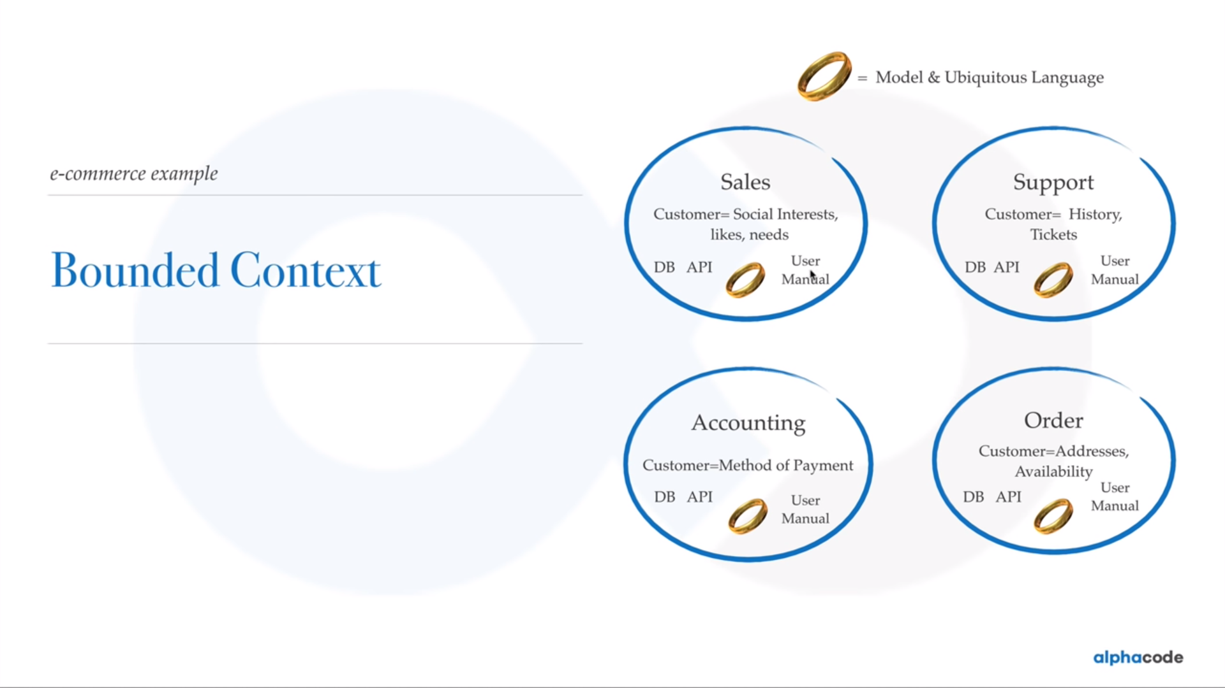

Slide 19
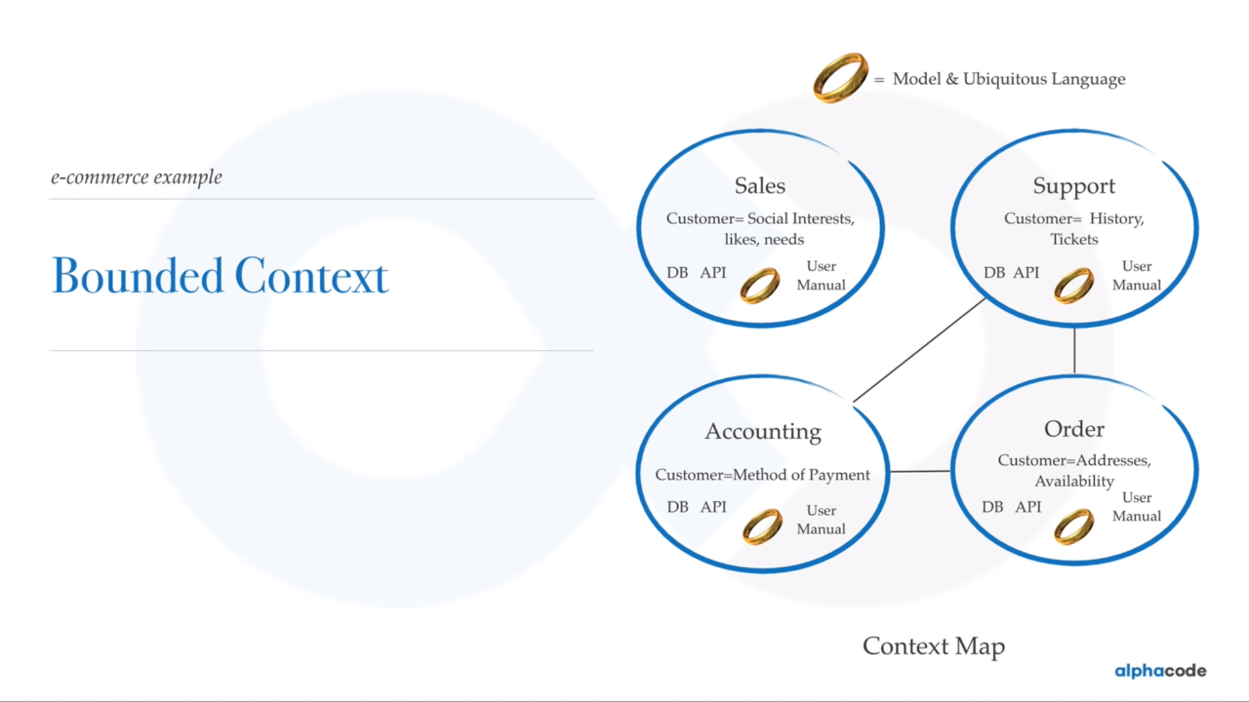

Slide 20
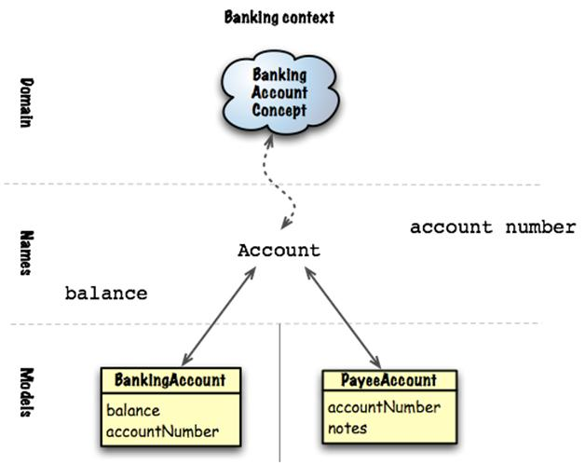

Slide 21
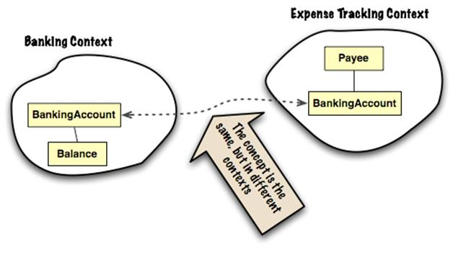

Slide 22
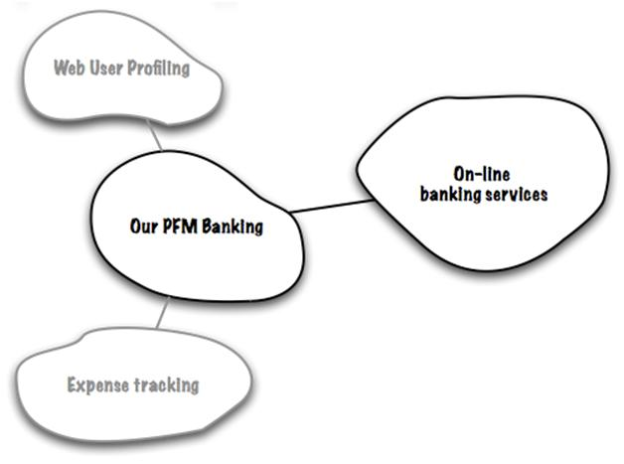
Personal Finance Management Application (PFM)

Slide 23
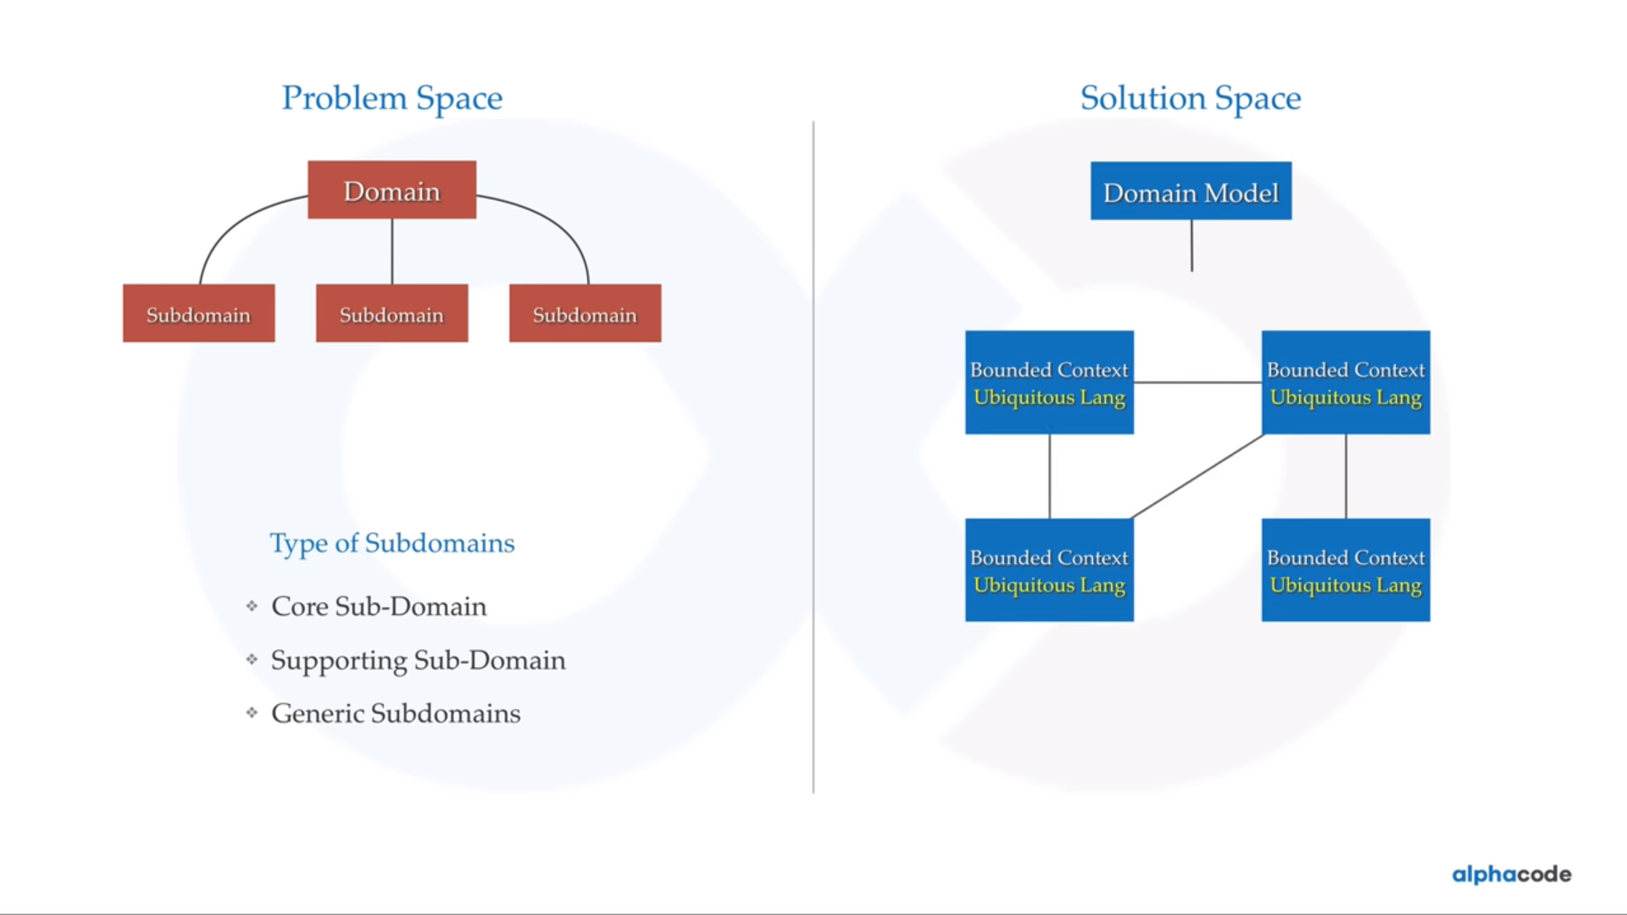

Slide 24
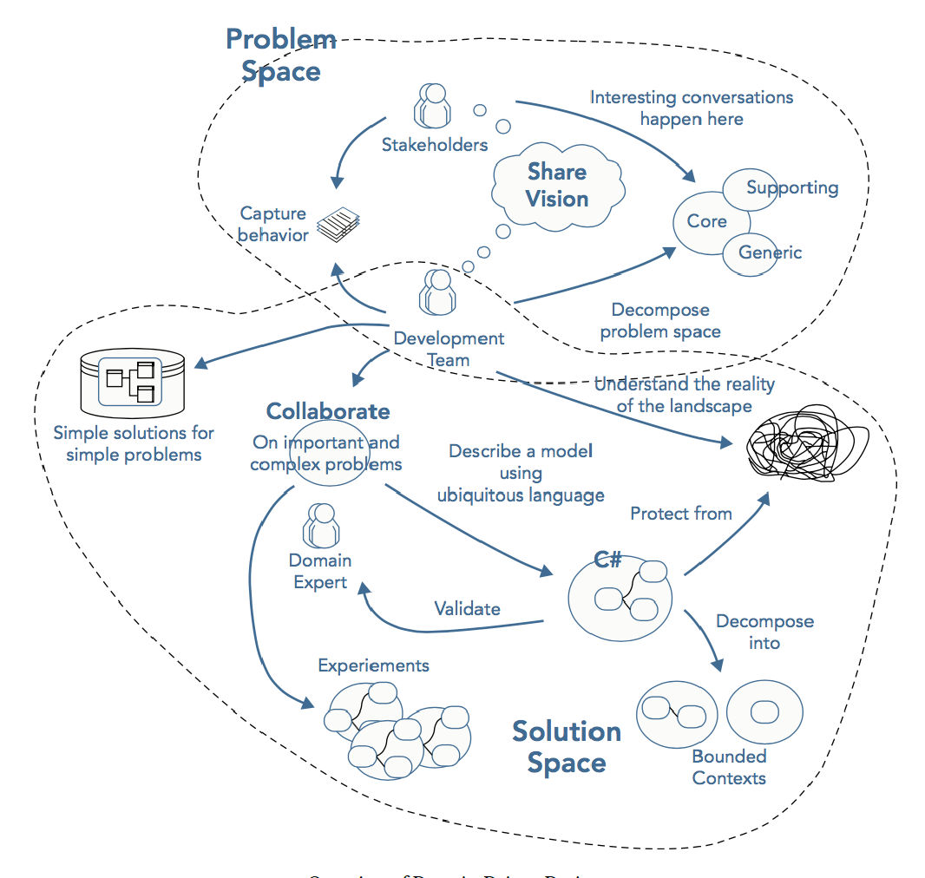

Slide 25


Slide 26
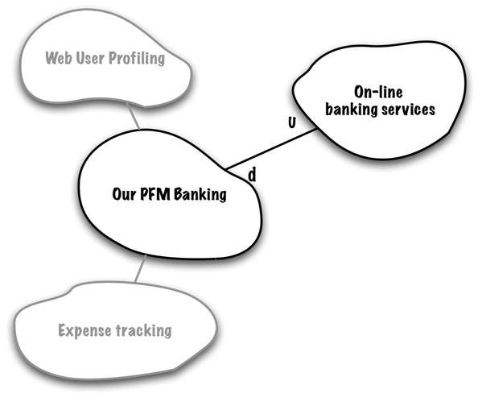
Up Stream and Down Stream

Slide 27
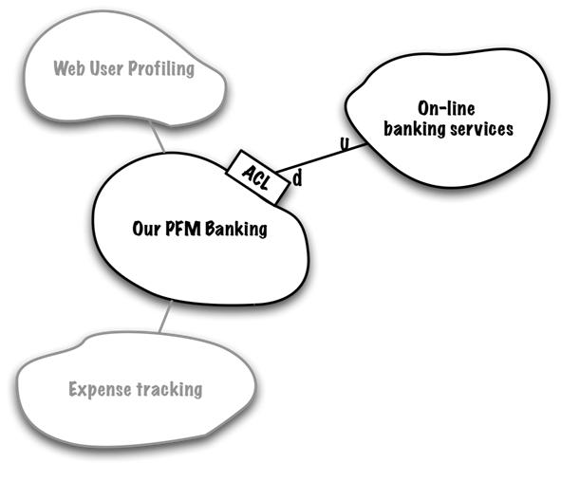
Anti corruption Layer

Slide 28
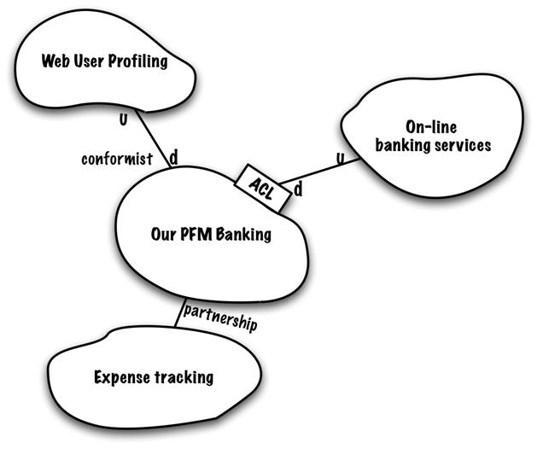

Slide 29
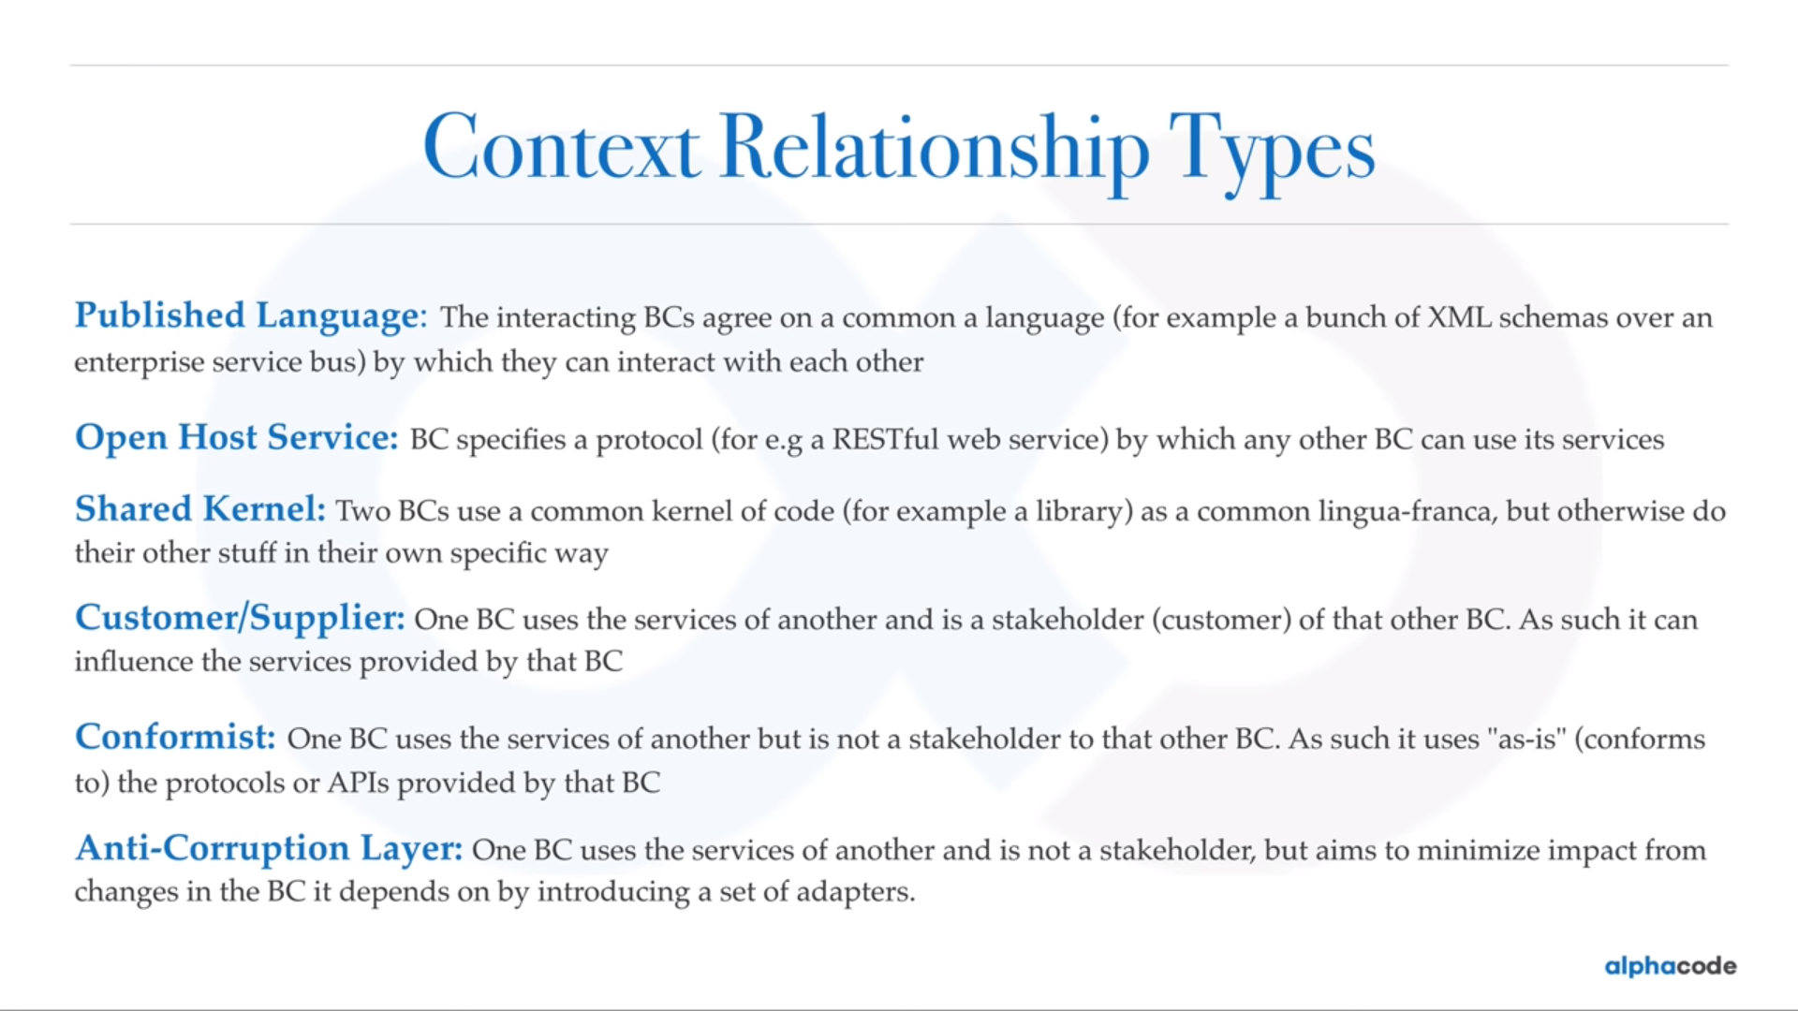

Slide 30
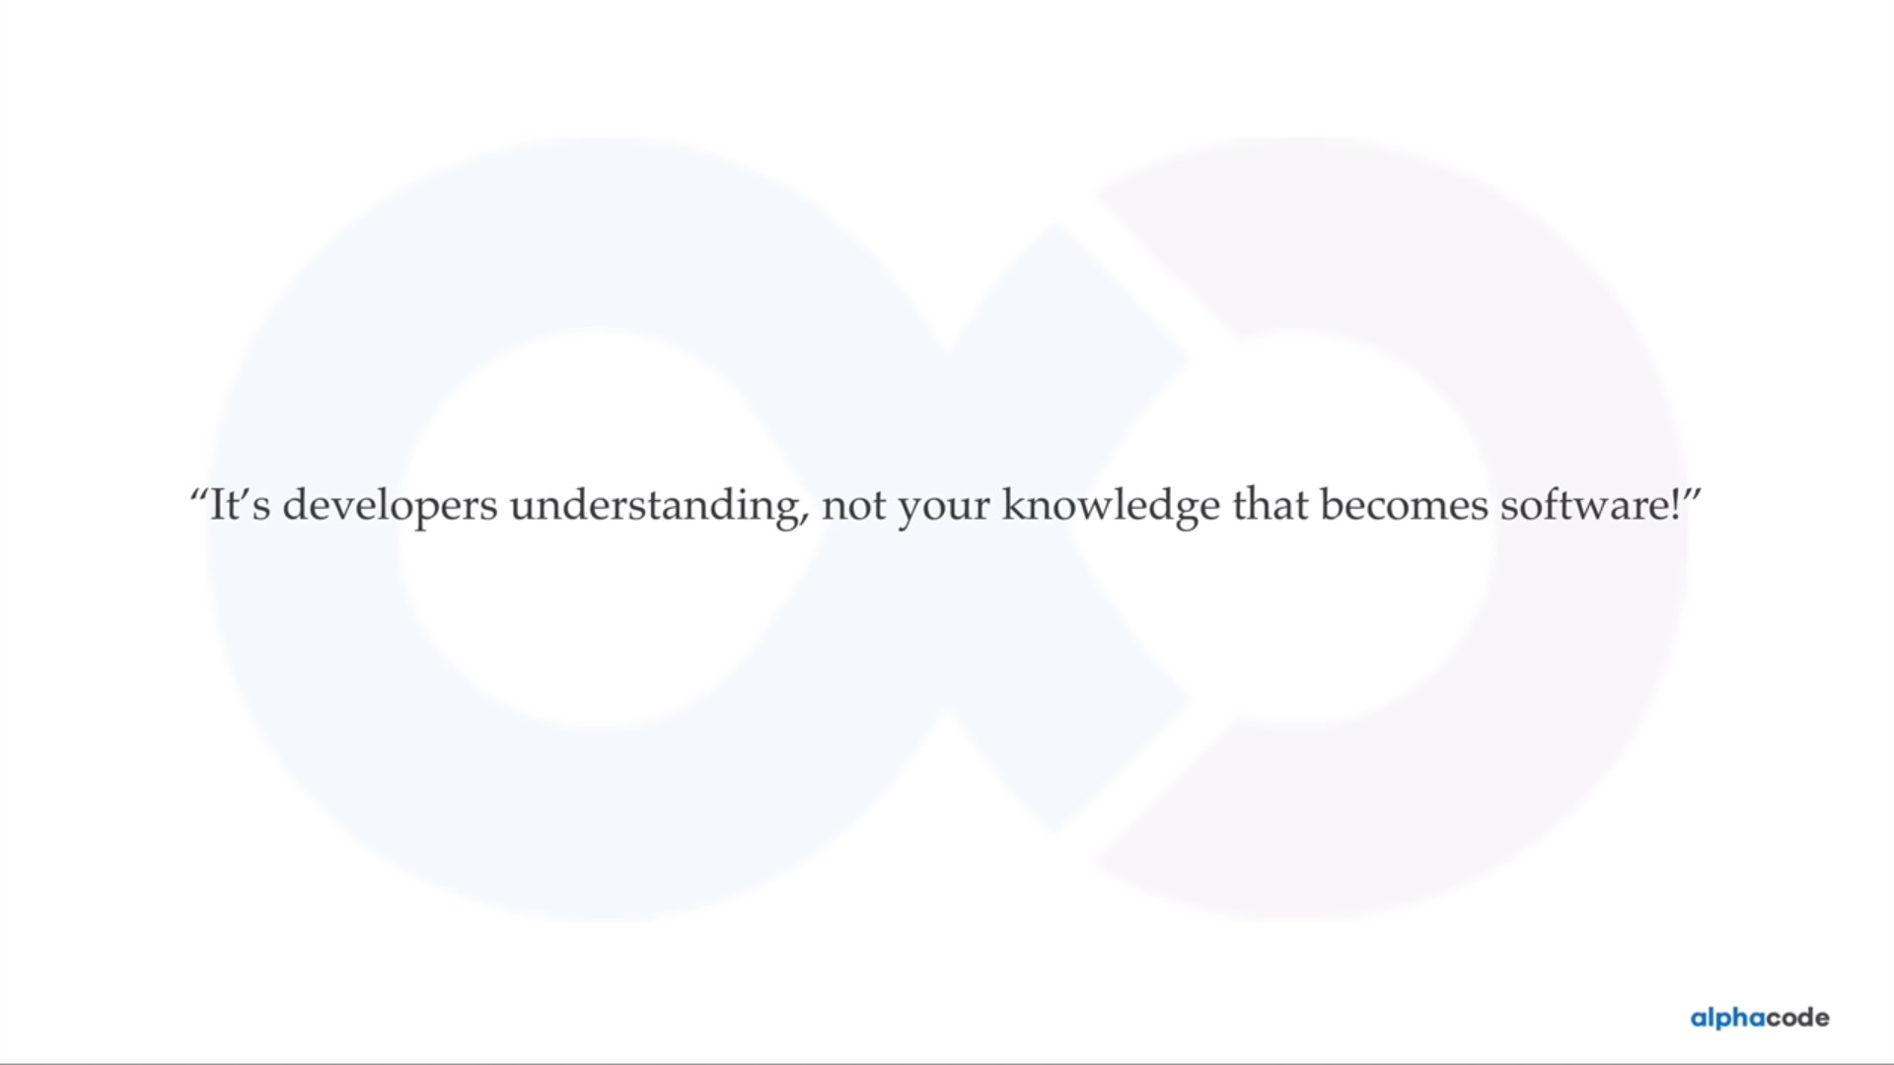

Slide 31
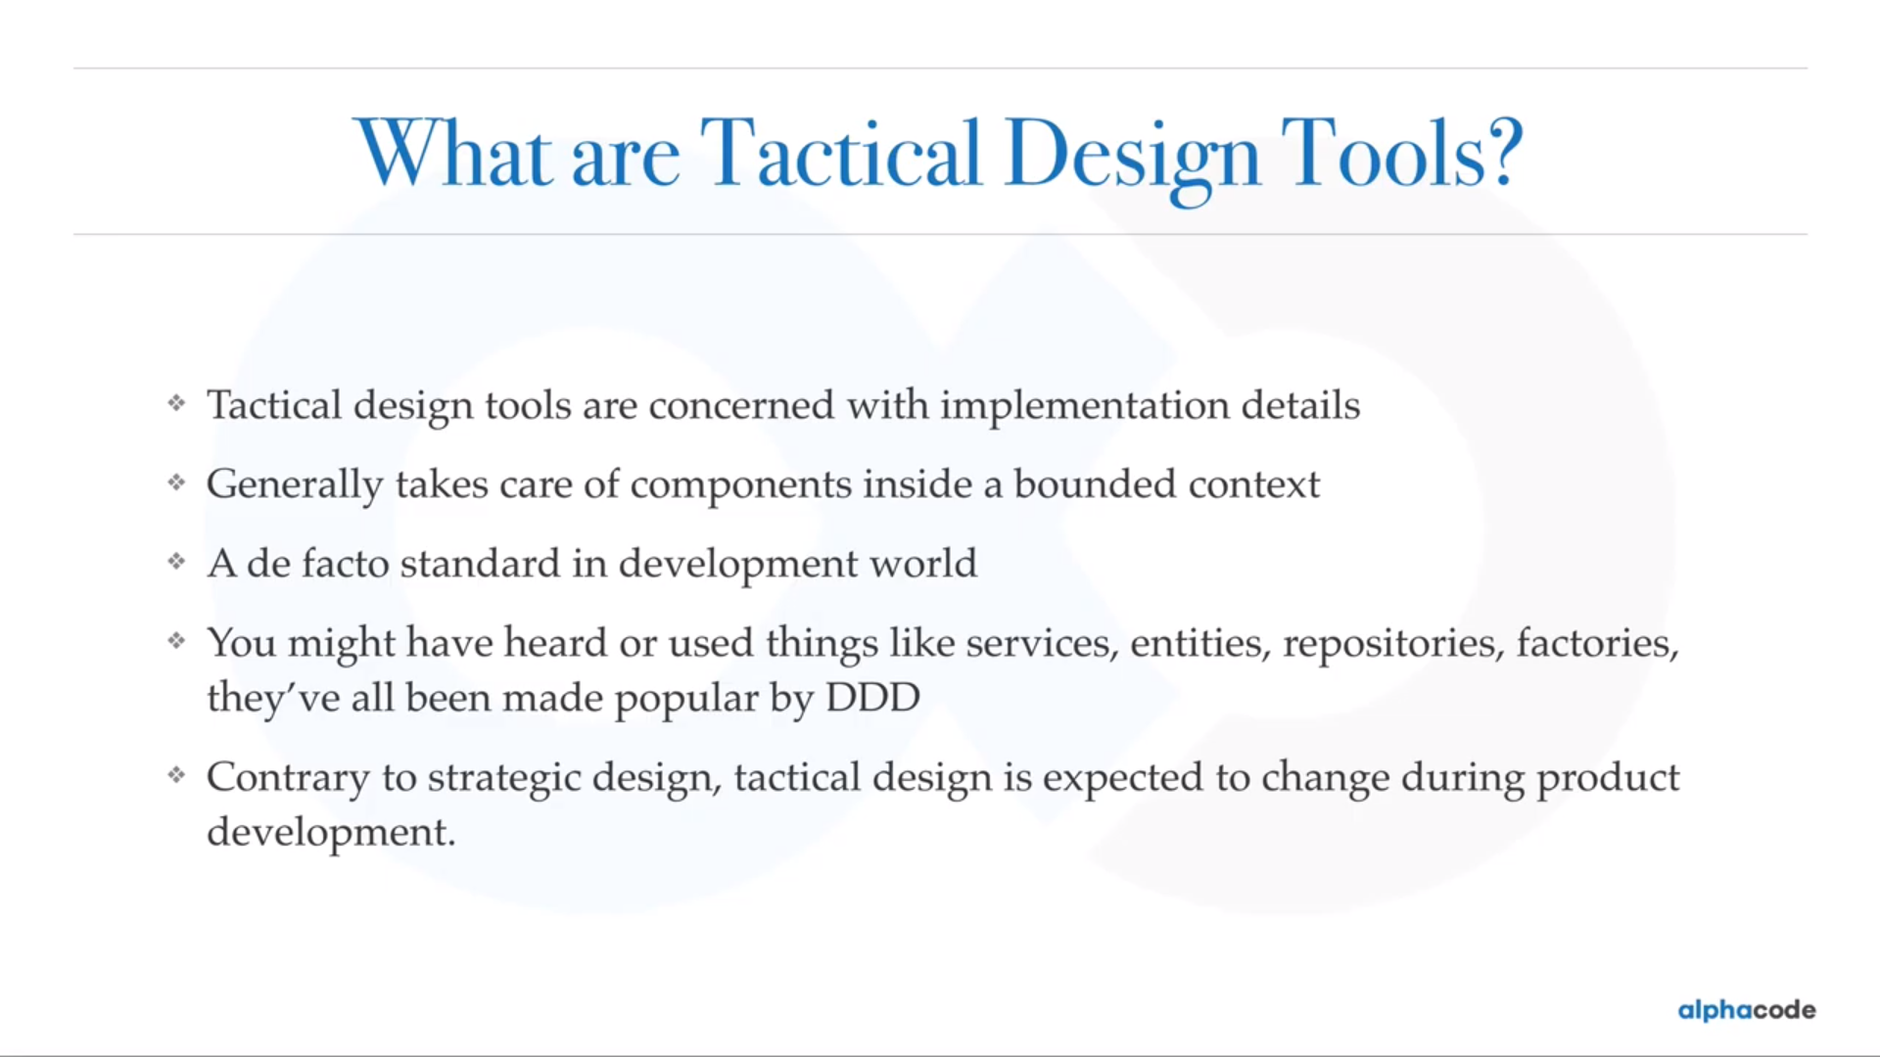

Slide 32
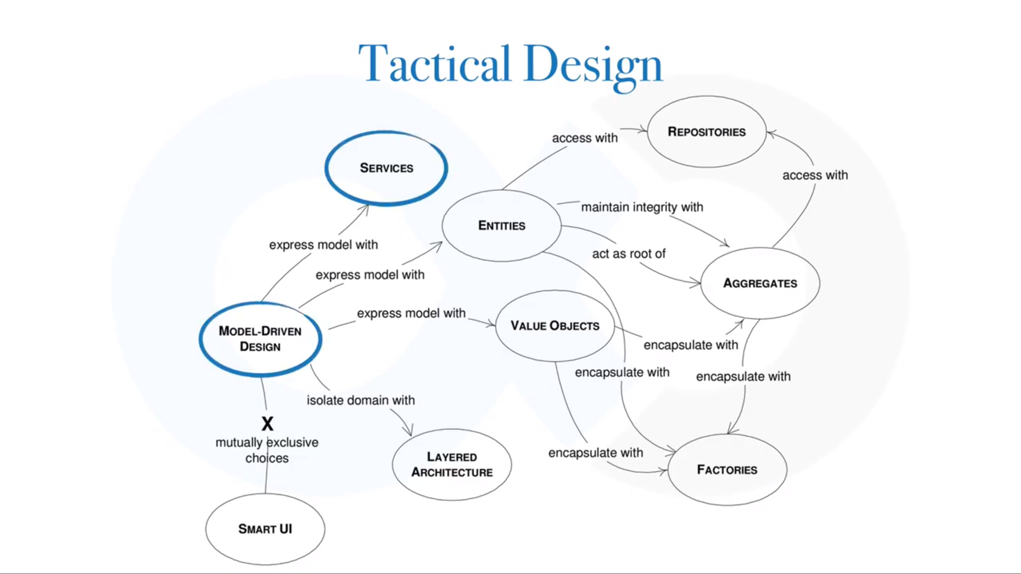

Slide 33
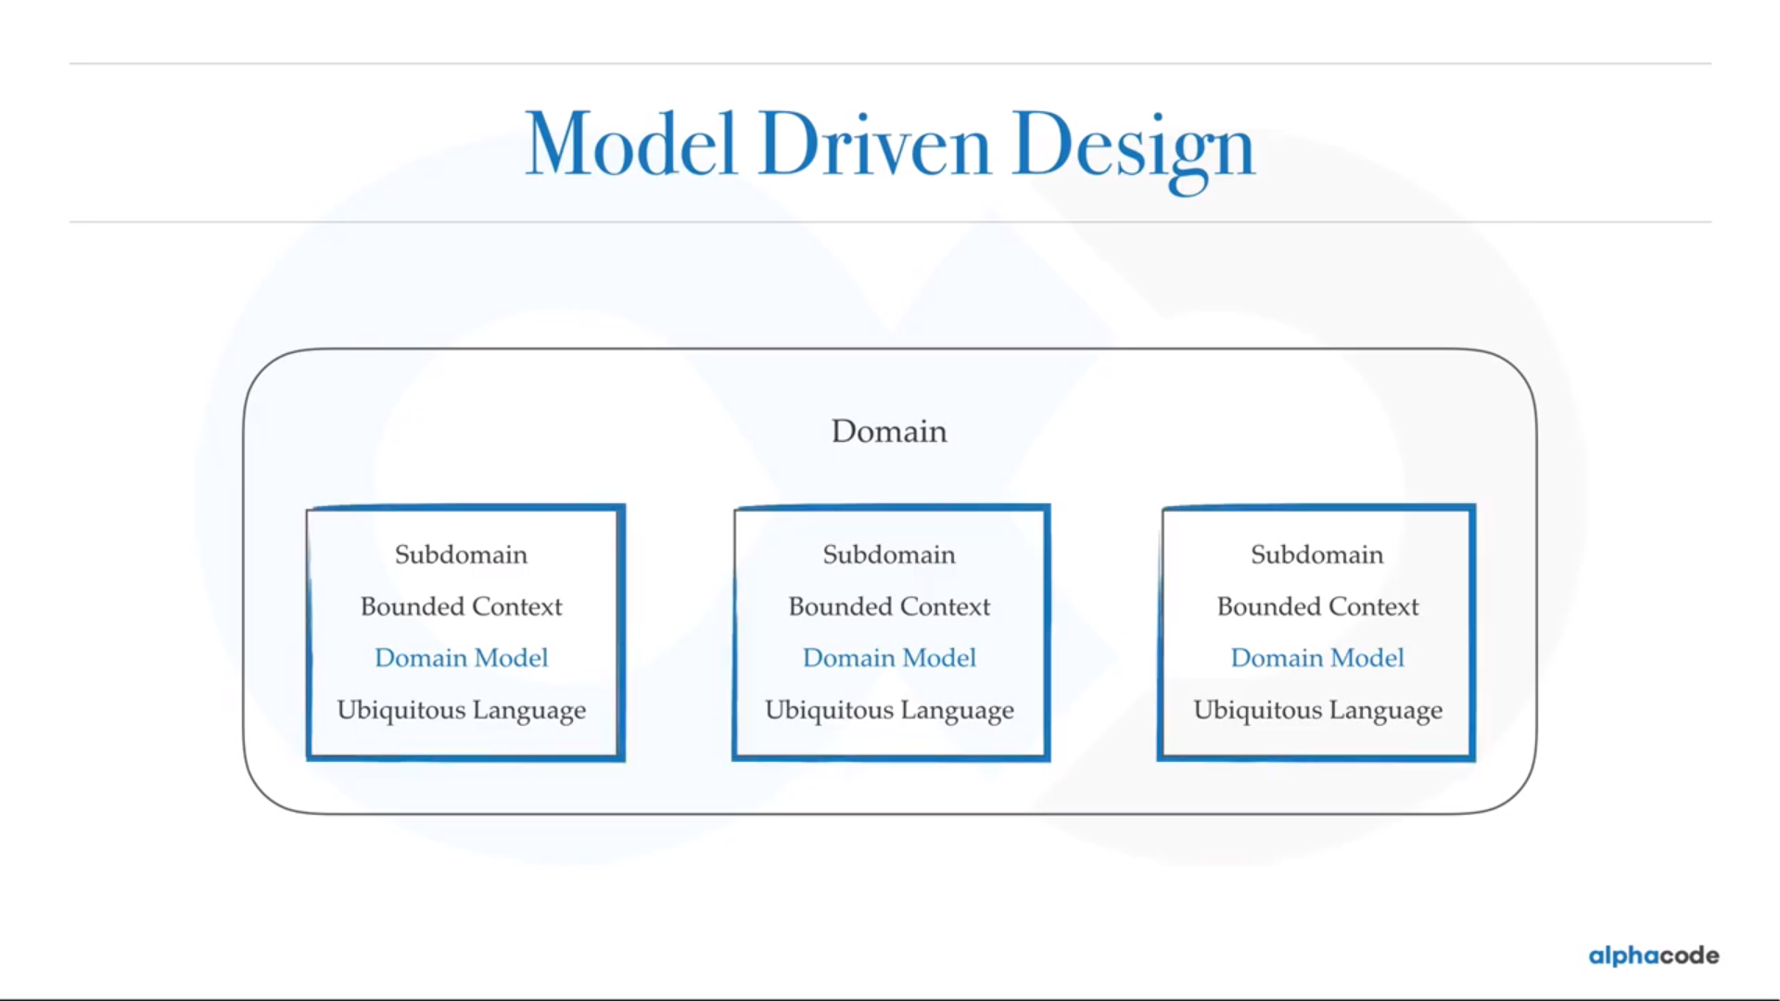

Slide 34
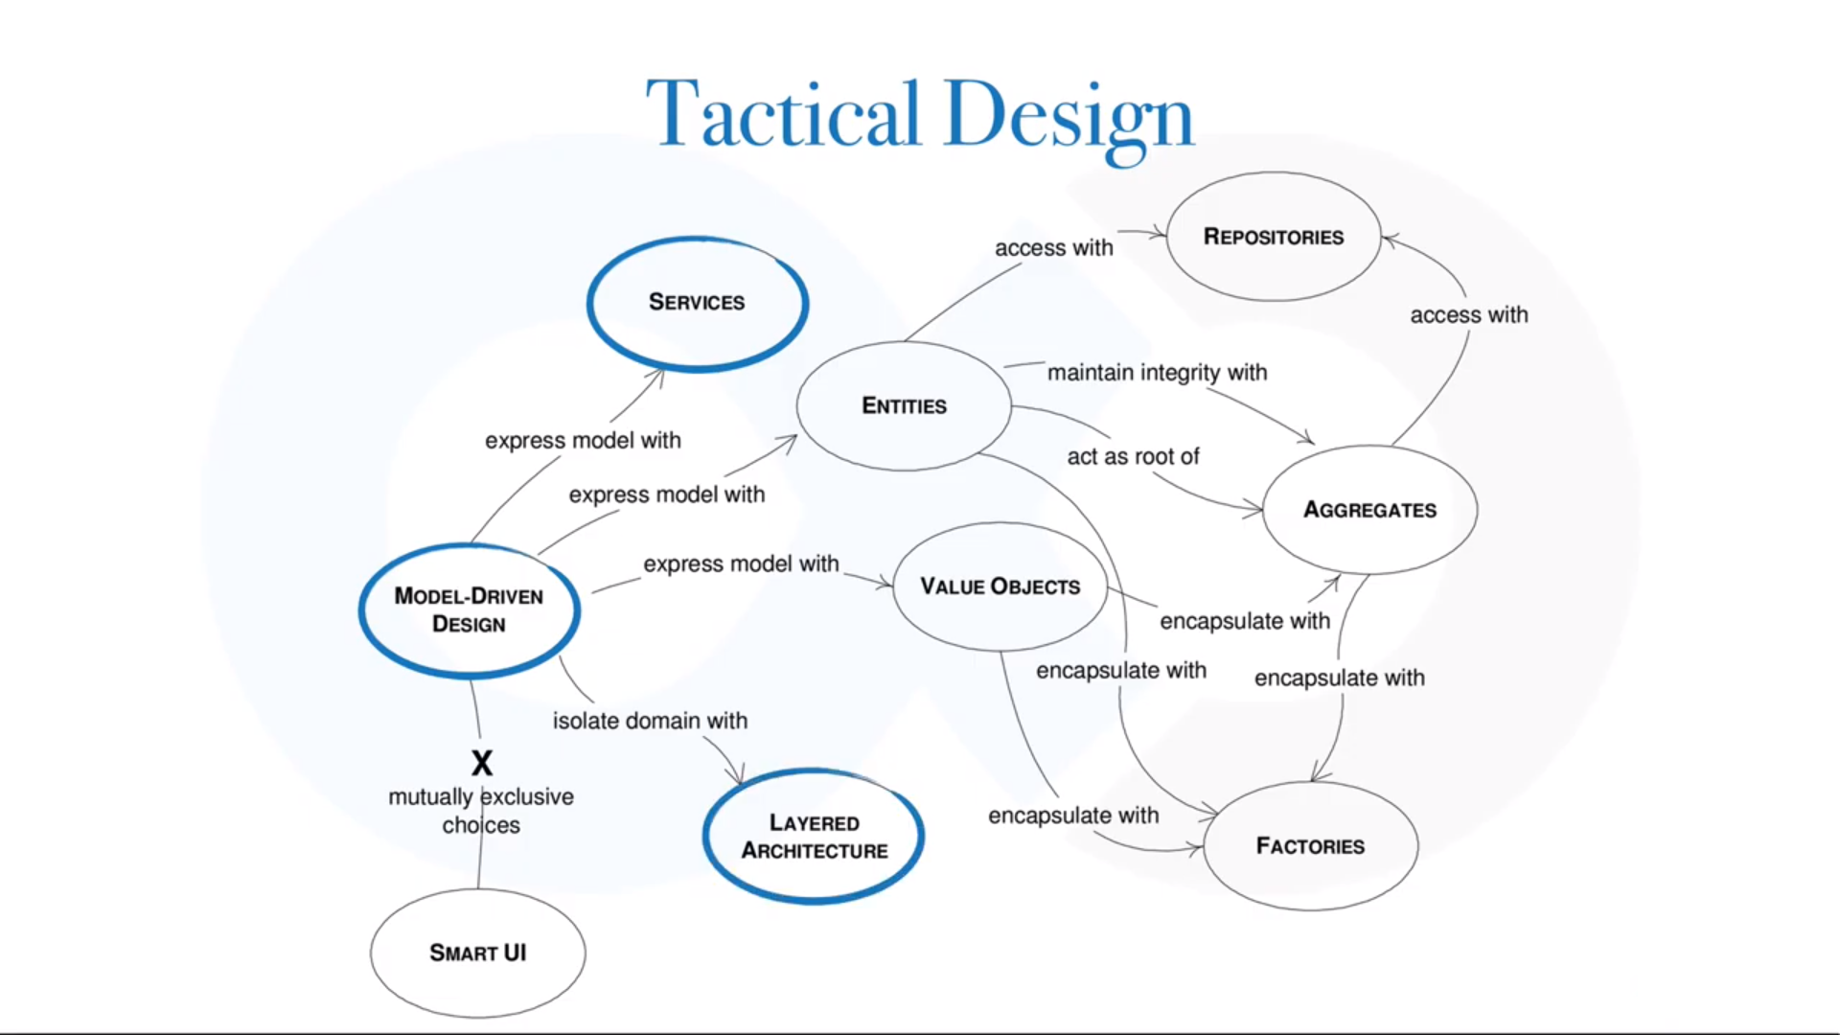

Slide 35
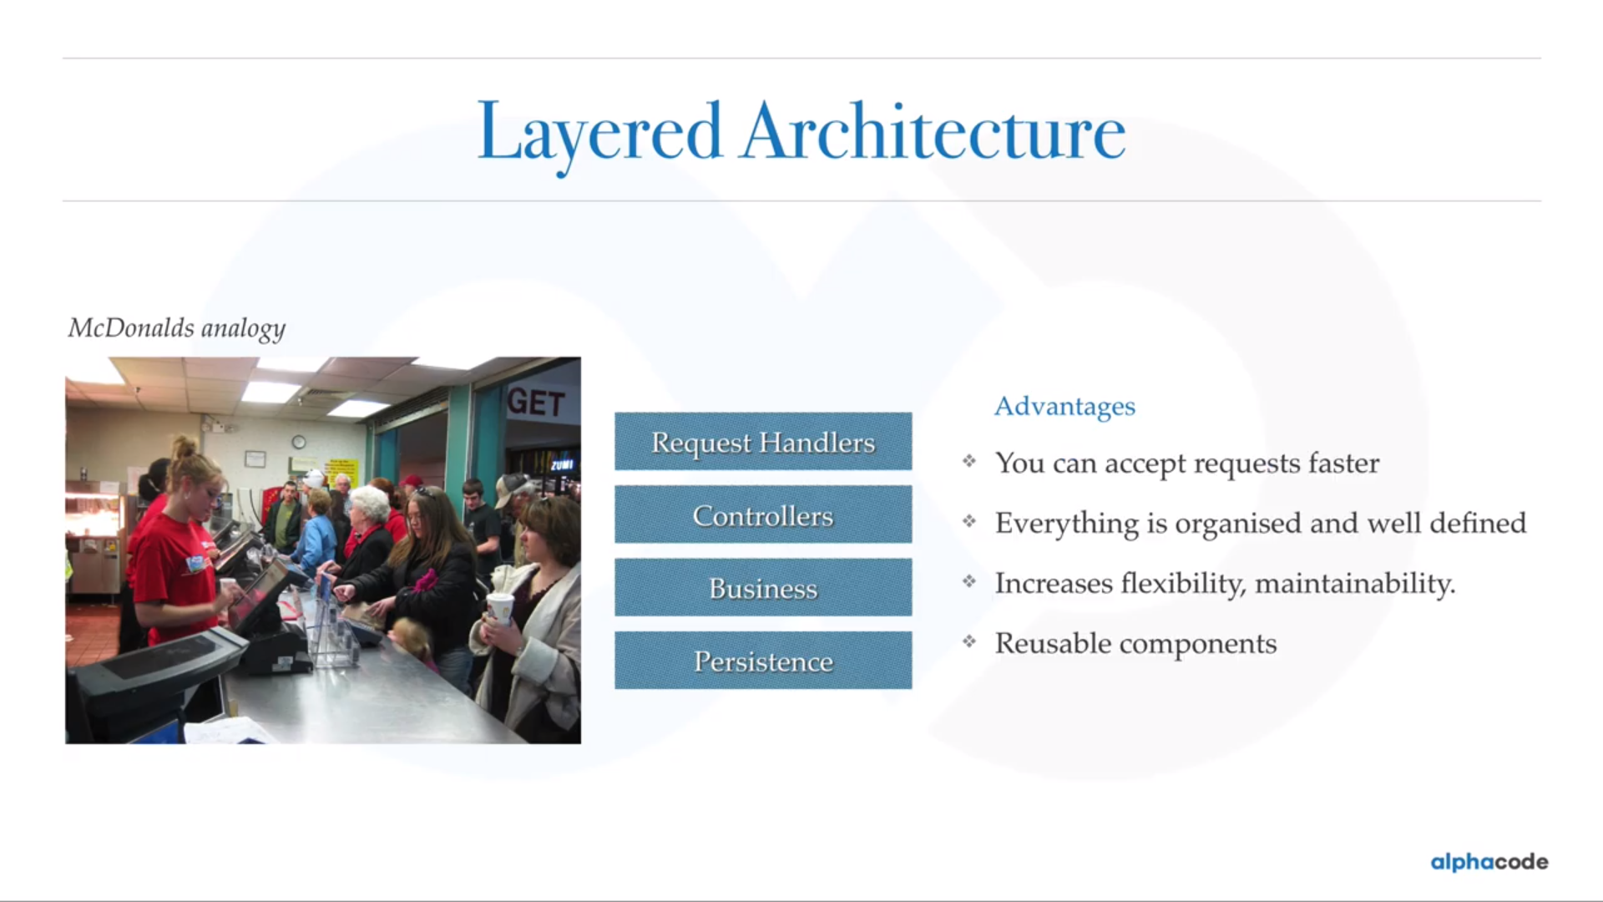

Slide 36
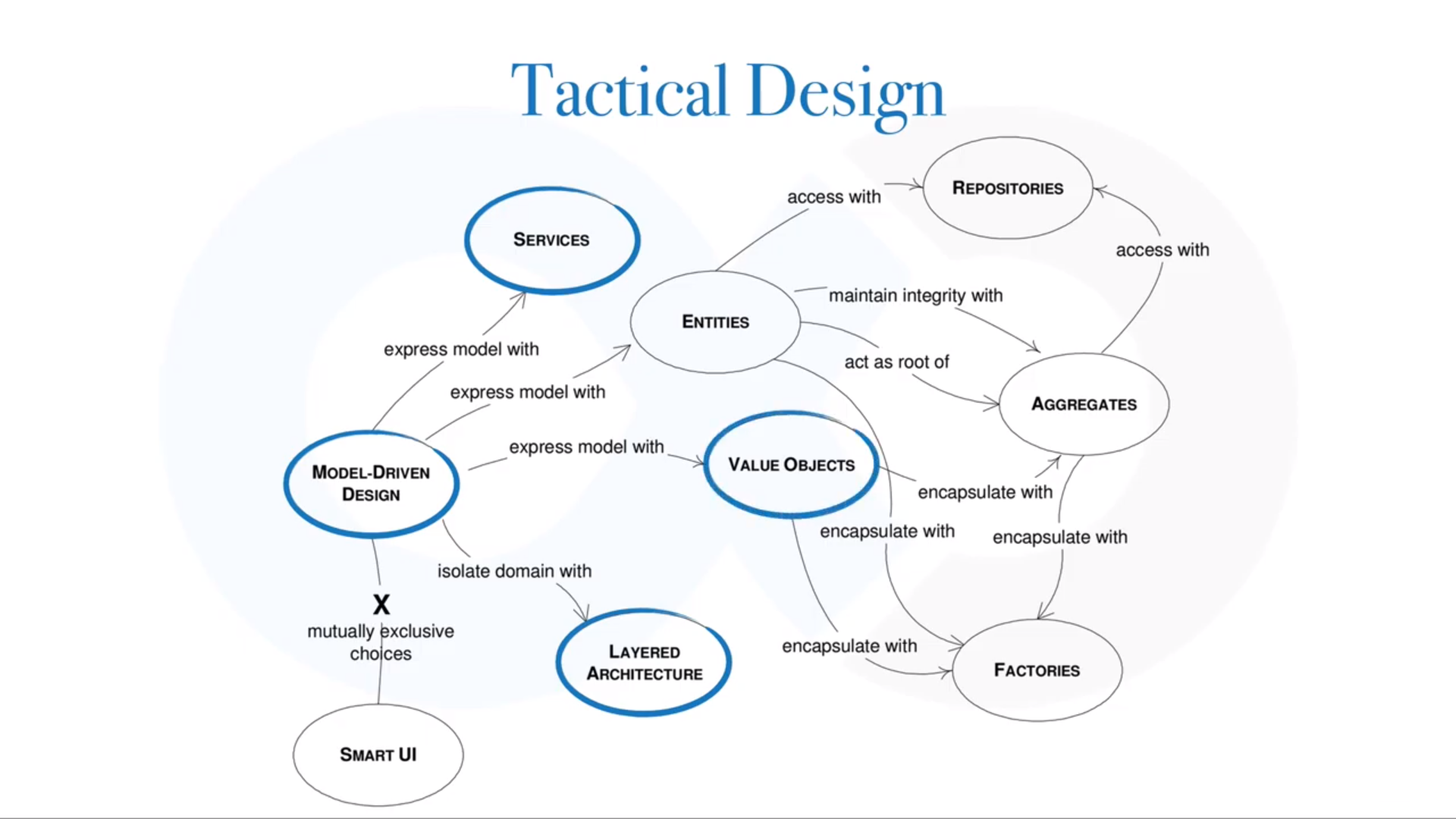

Slide 37
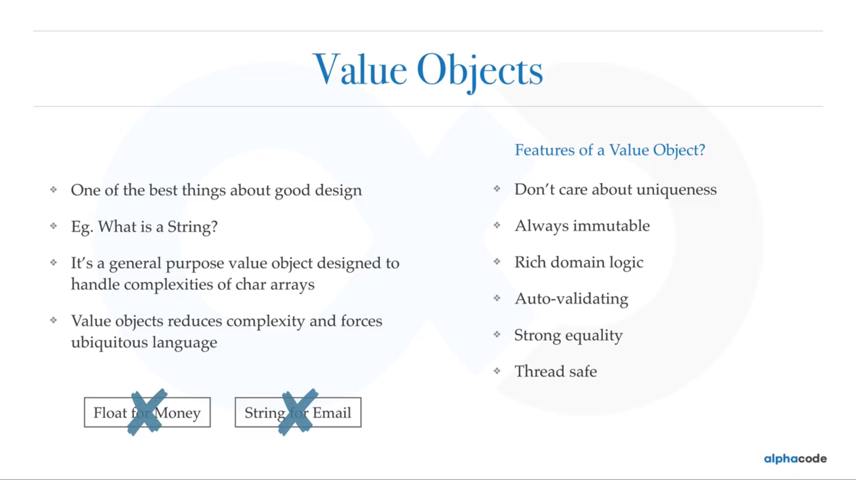

Slide 38
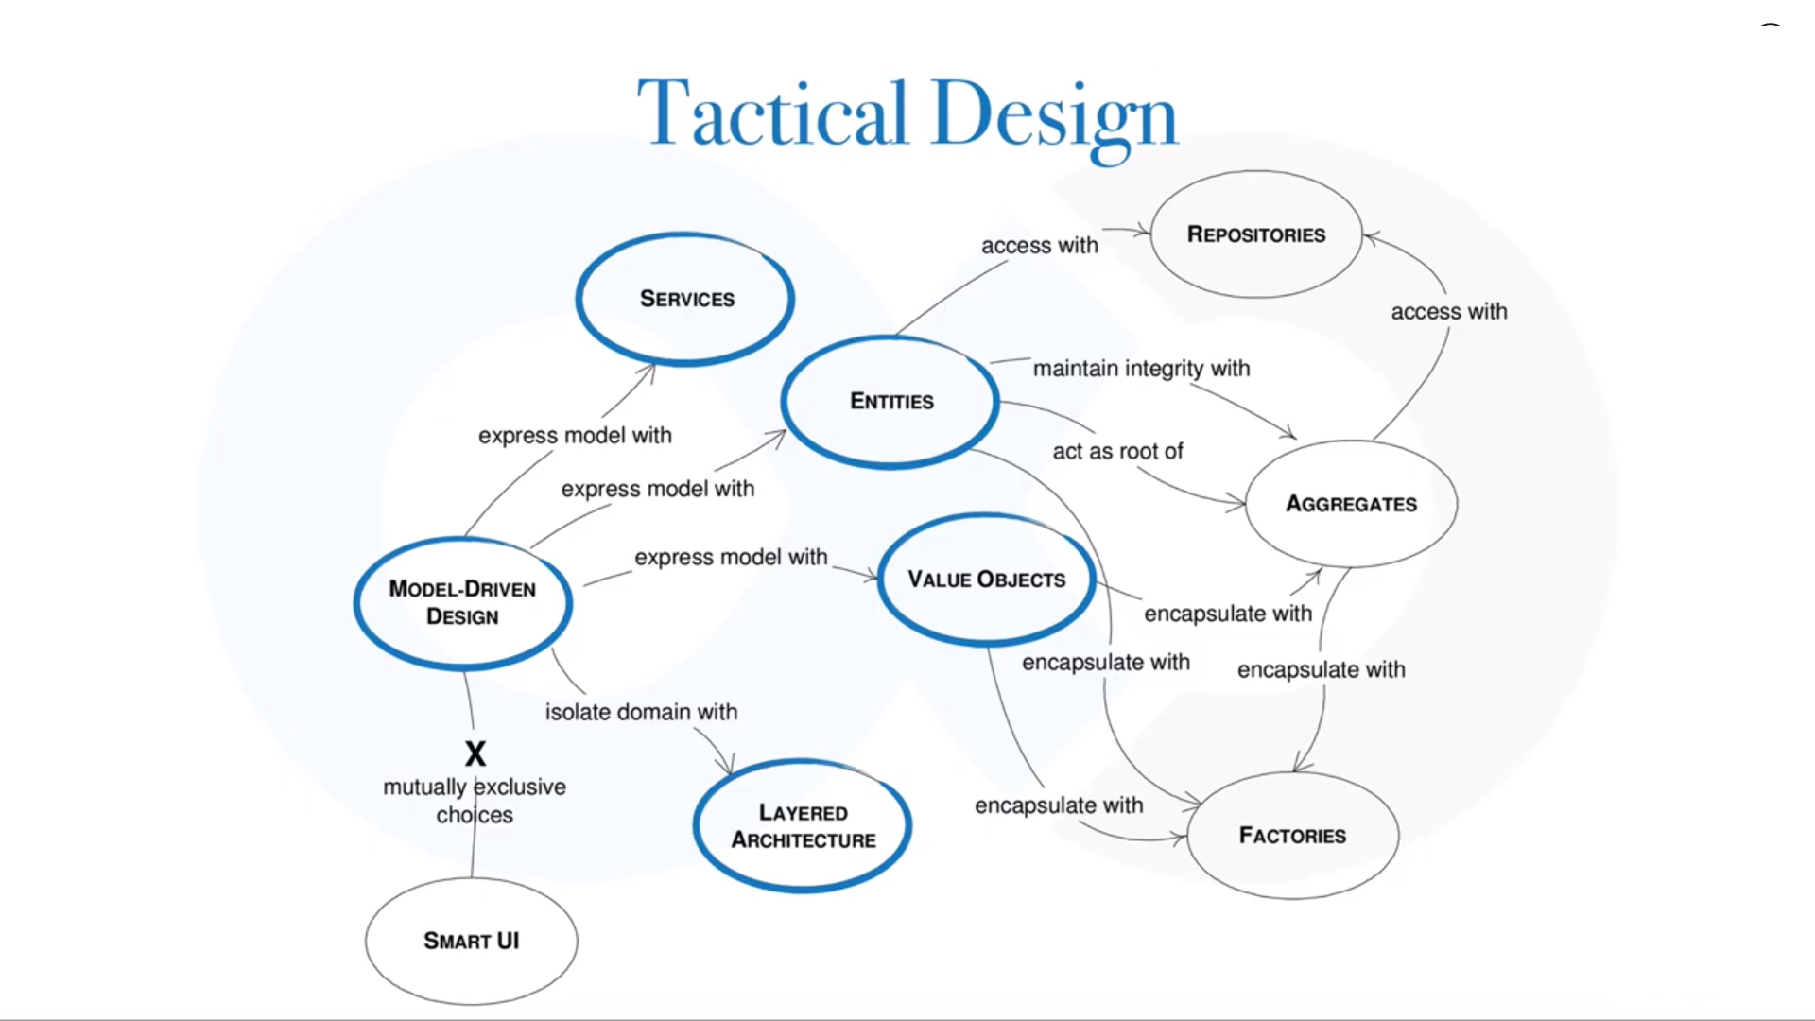

Slide 39
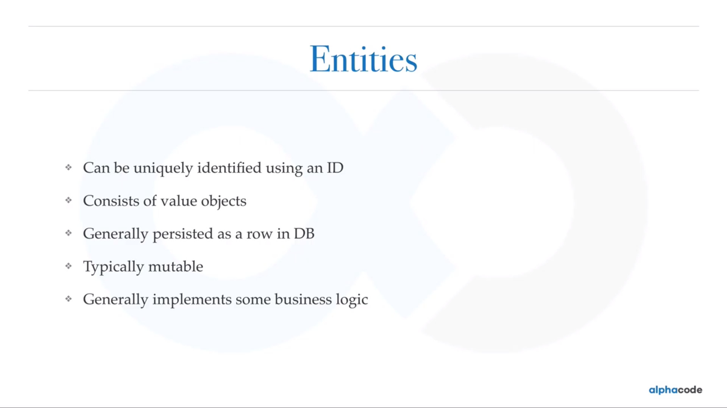

Slide 40
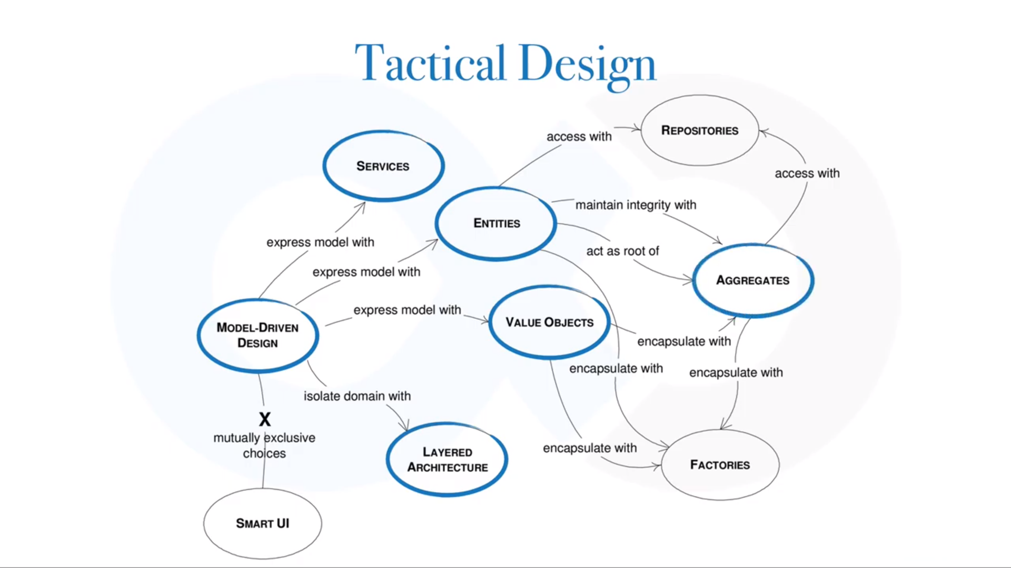

Slide 41
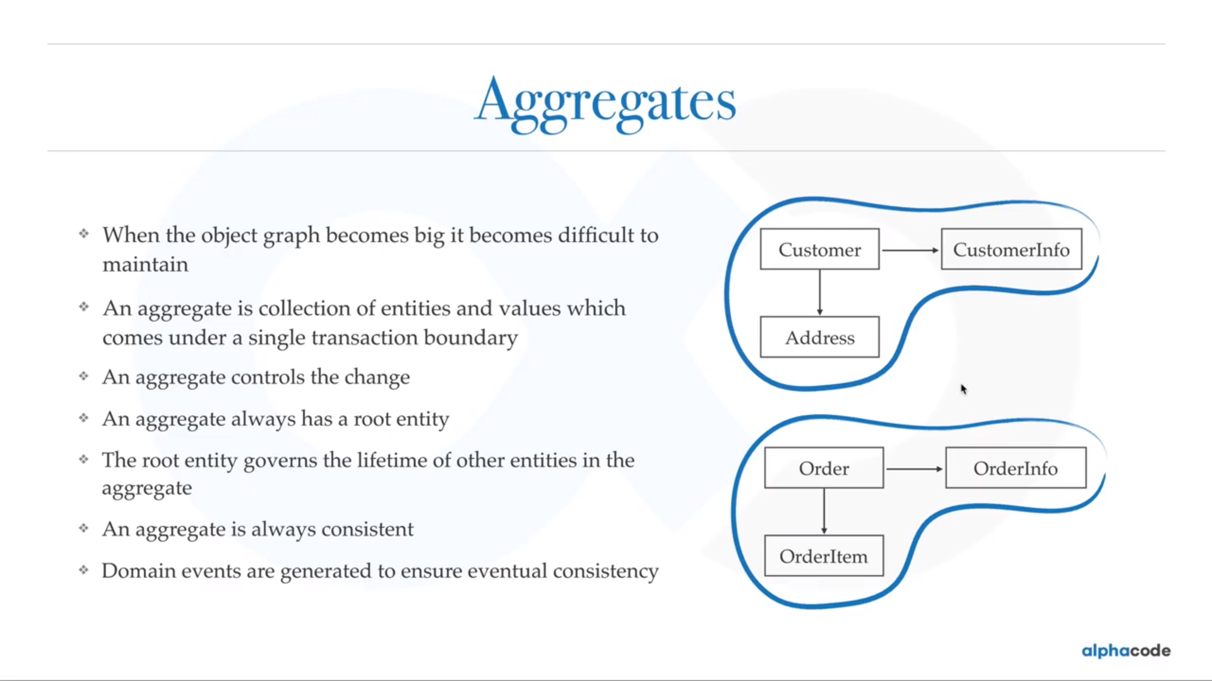

Slide 42
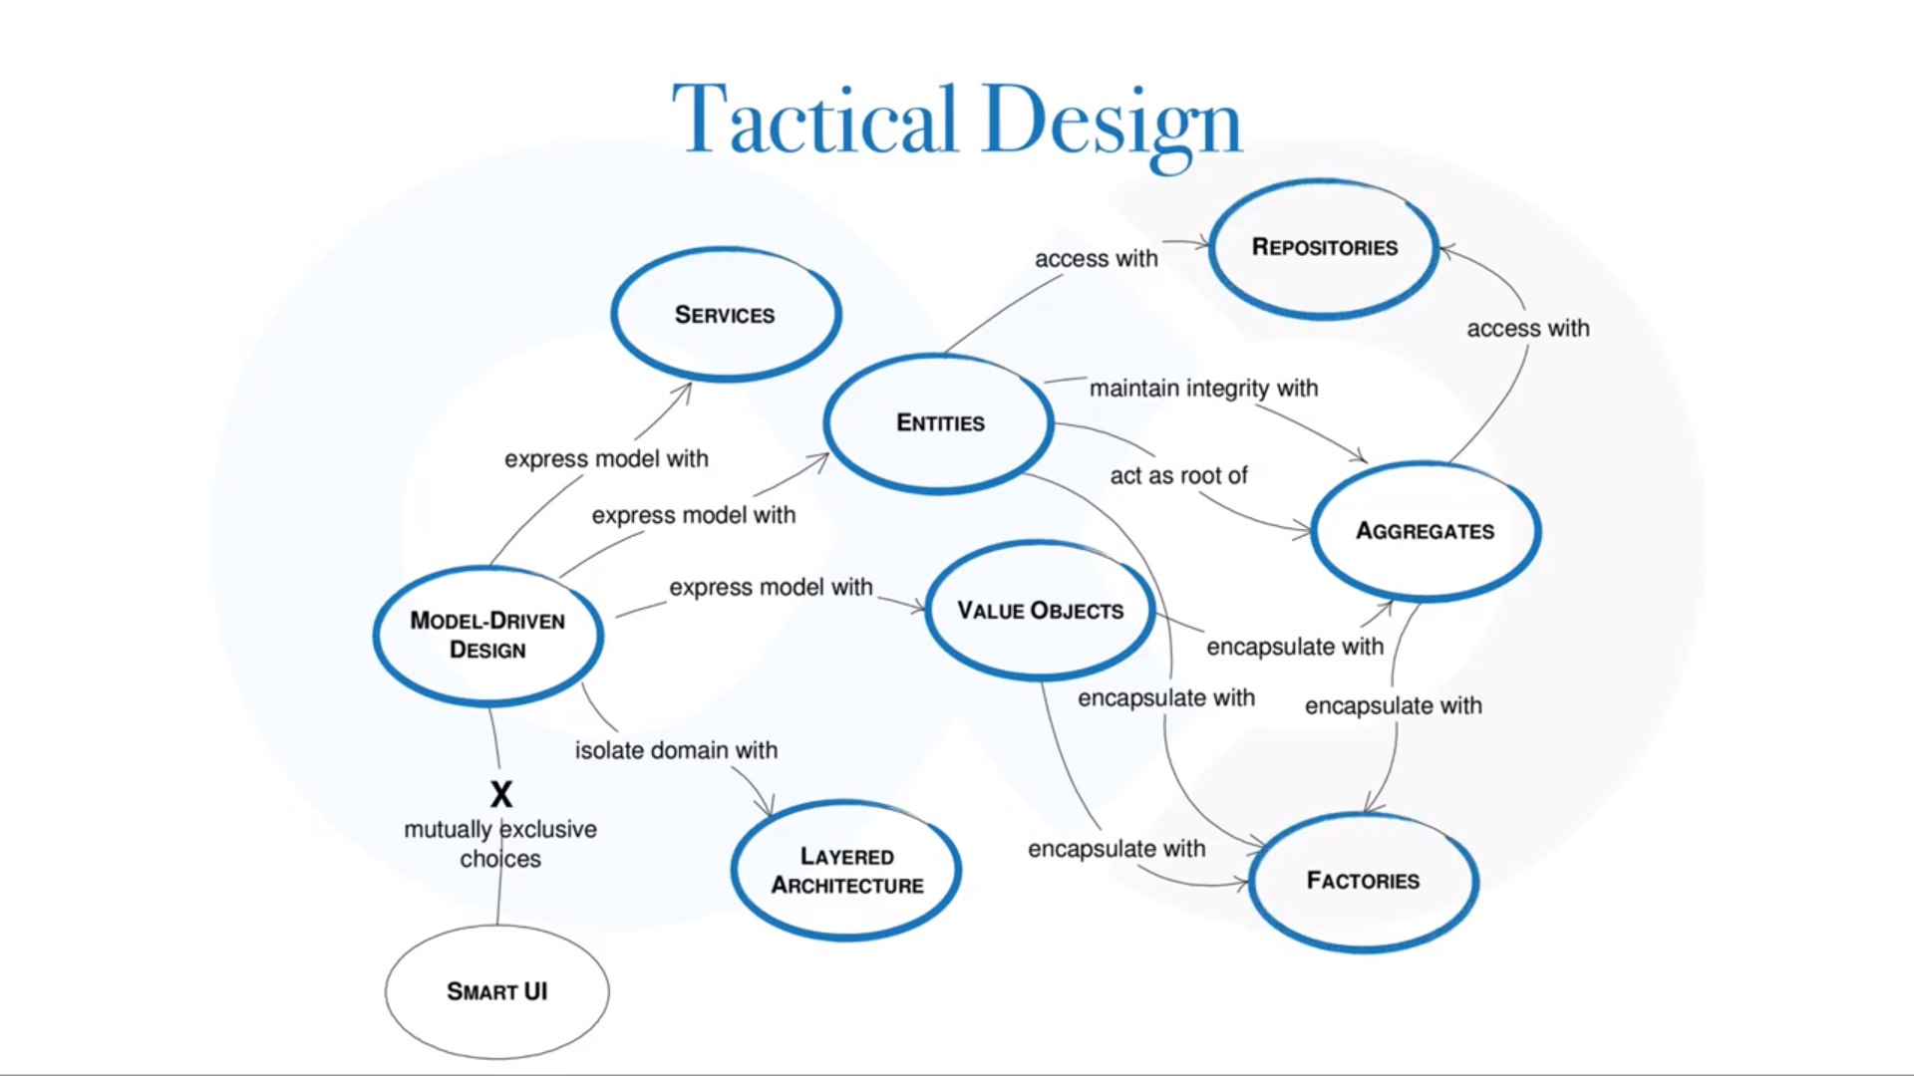

Slide 43
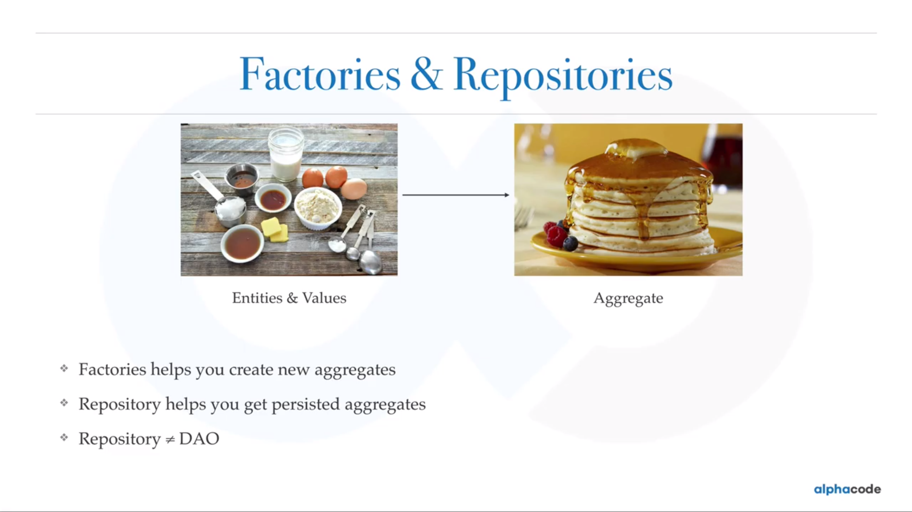

Slide 44
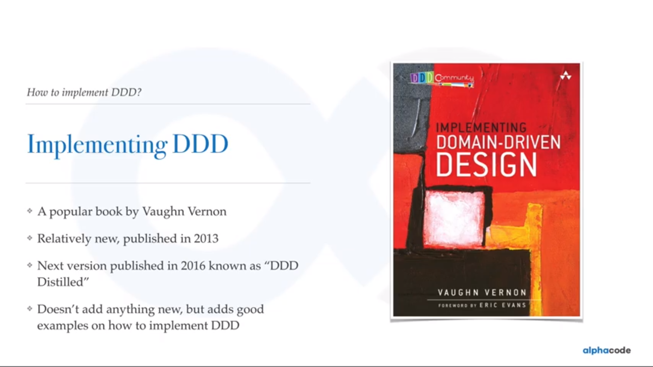

Slide 45
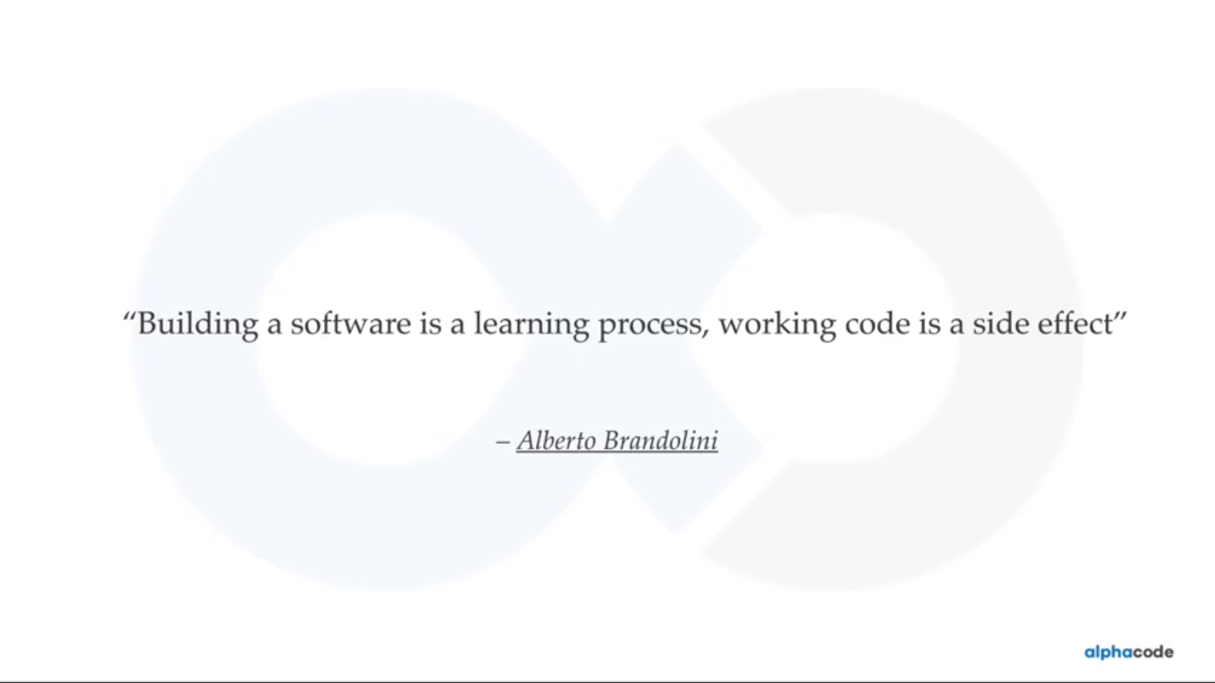

Slide 46
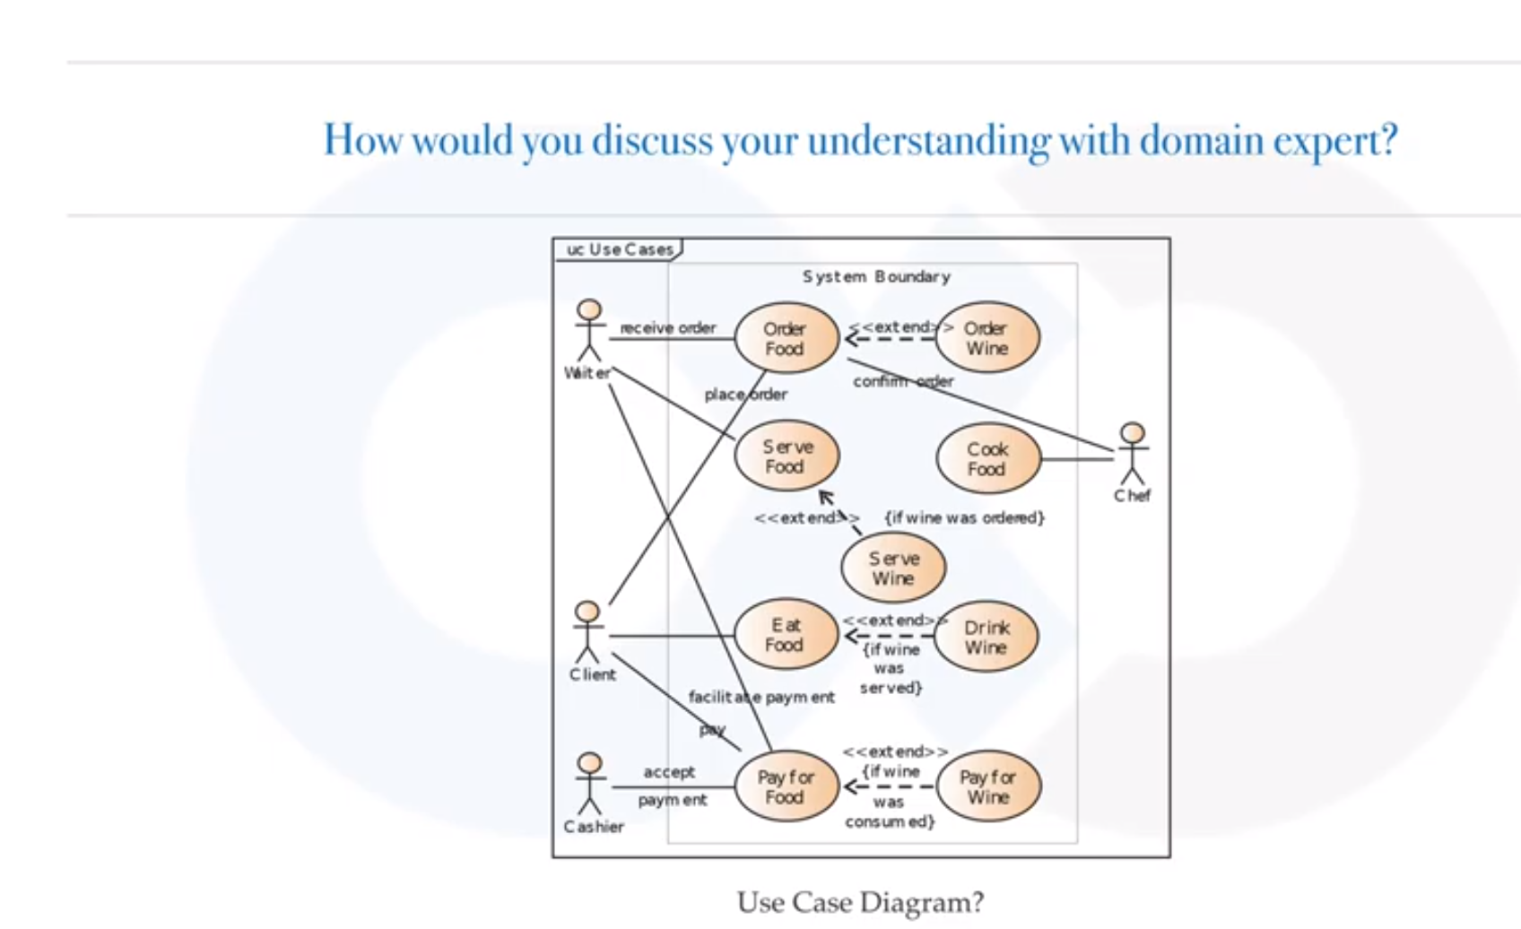
Obsolete

Slide 47
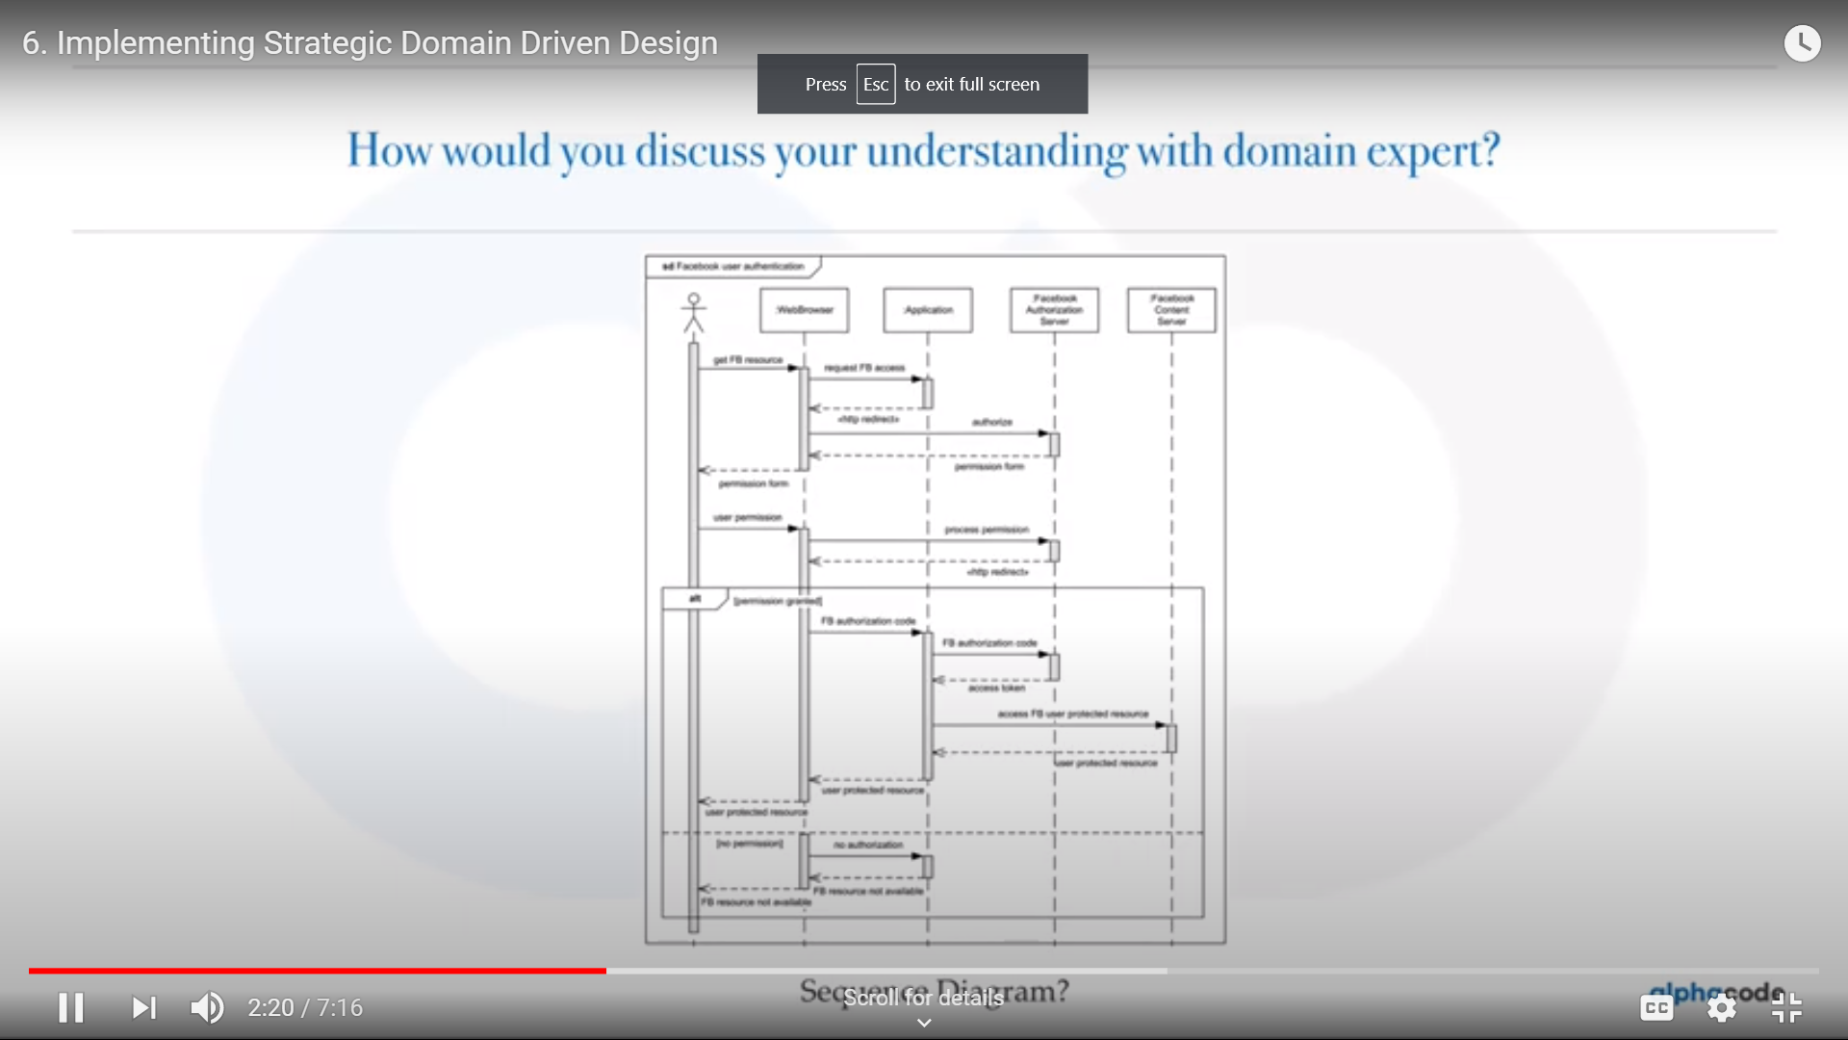
Obsolete
Sequence Diagram

Slide 48
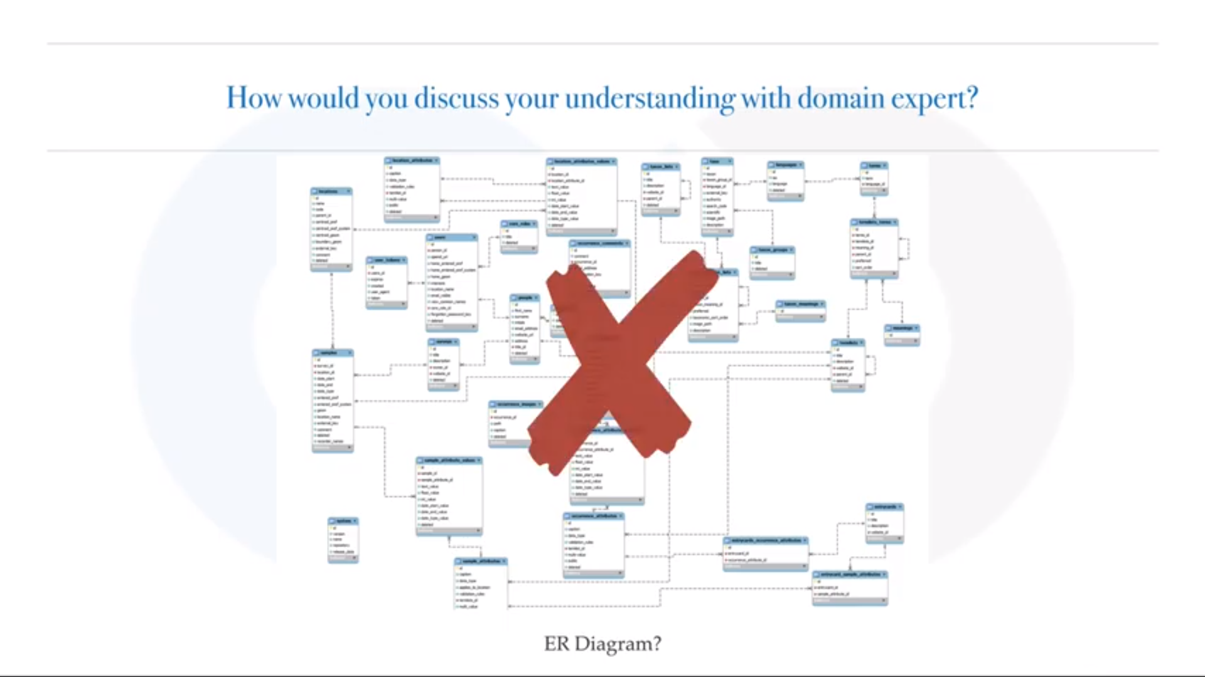
Obsolete

Slide 49
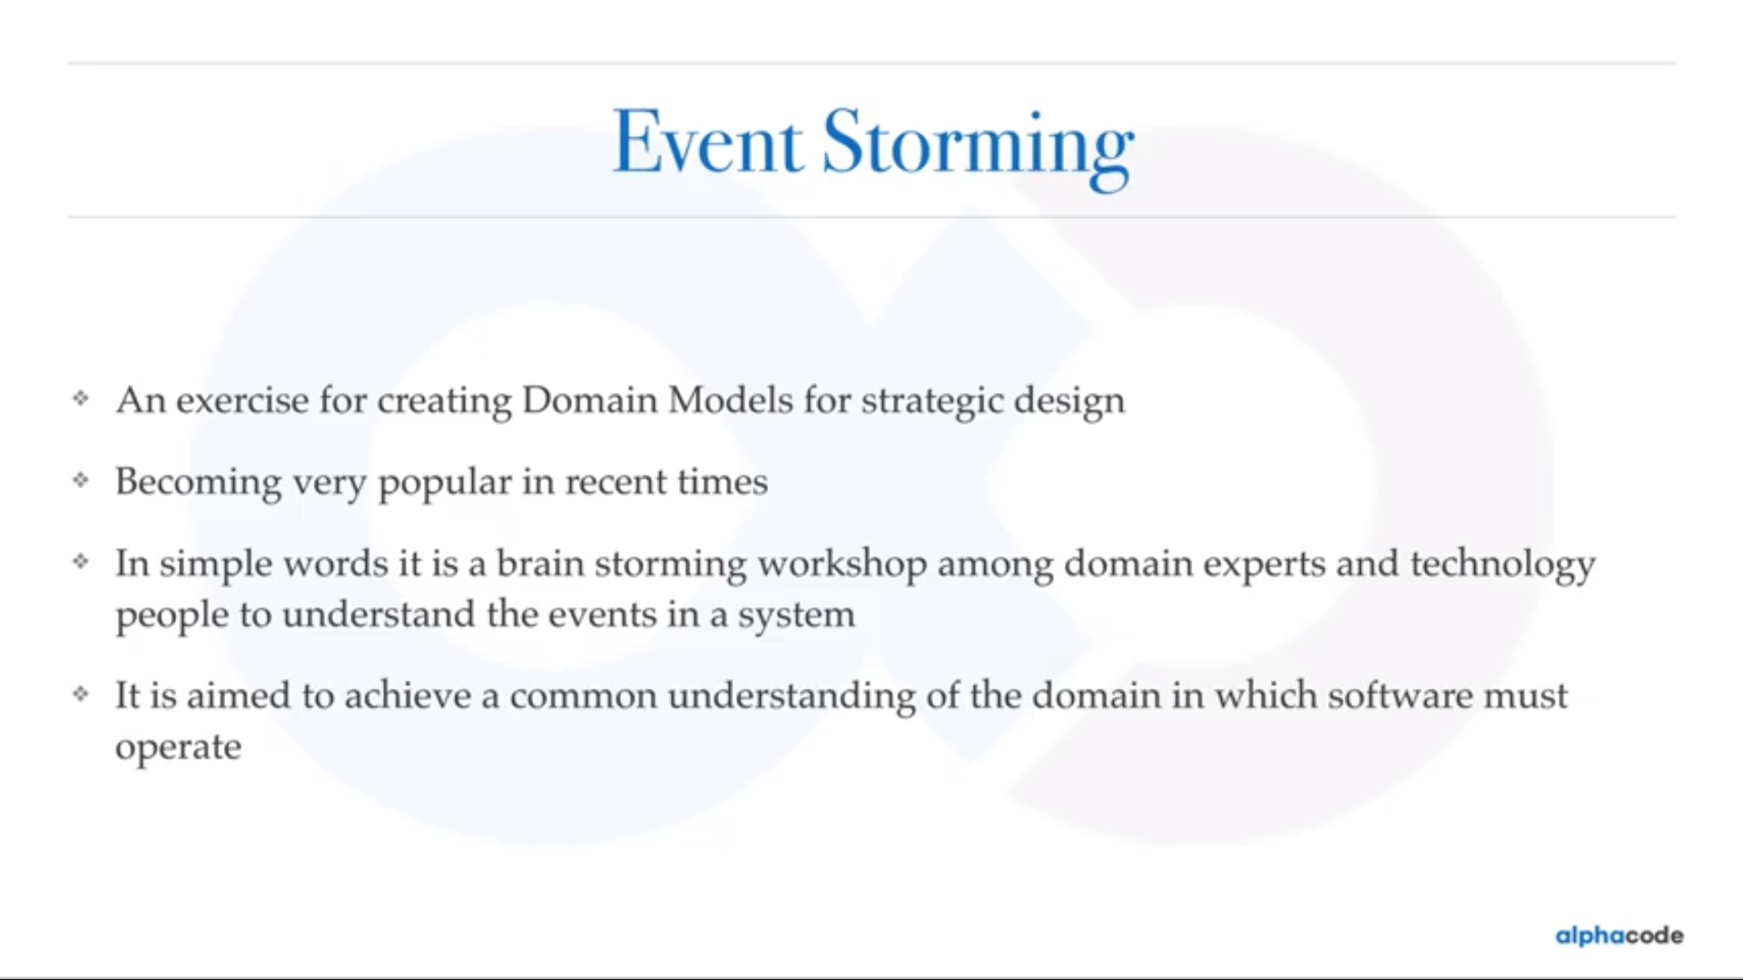

Slide 50
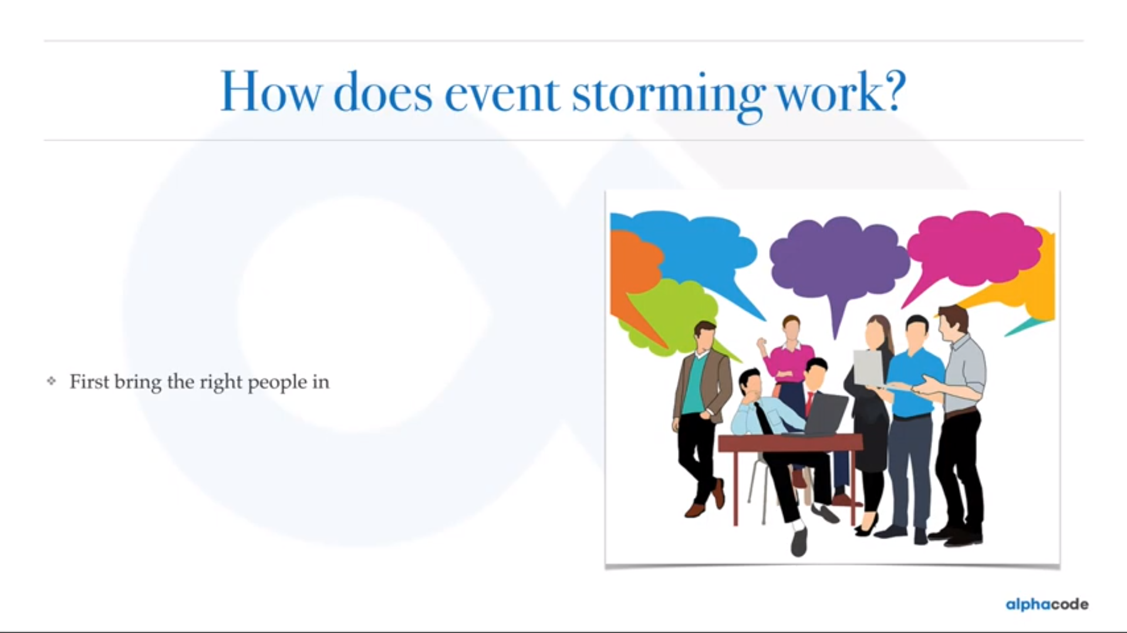

Slide 51
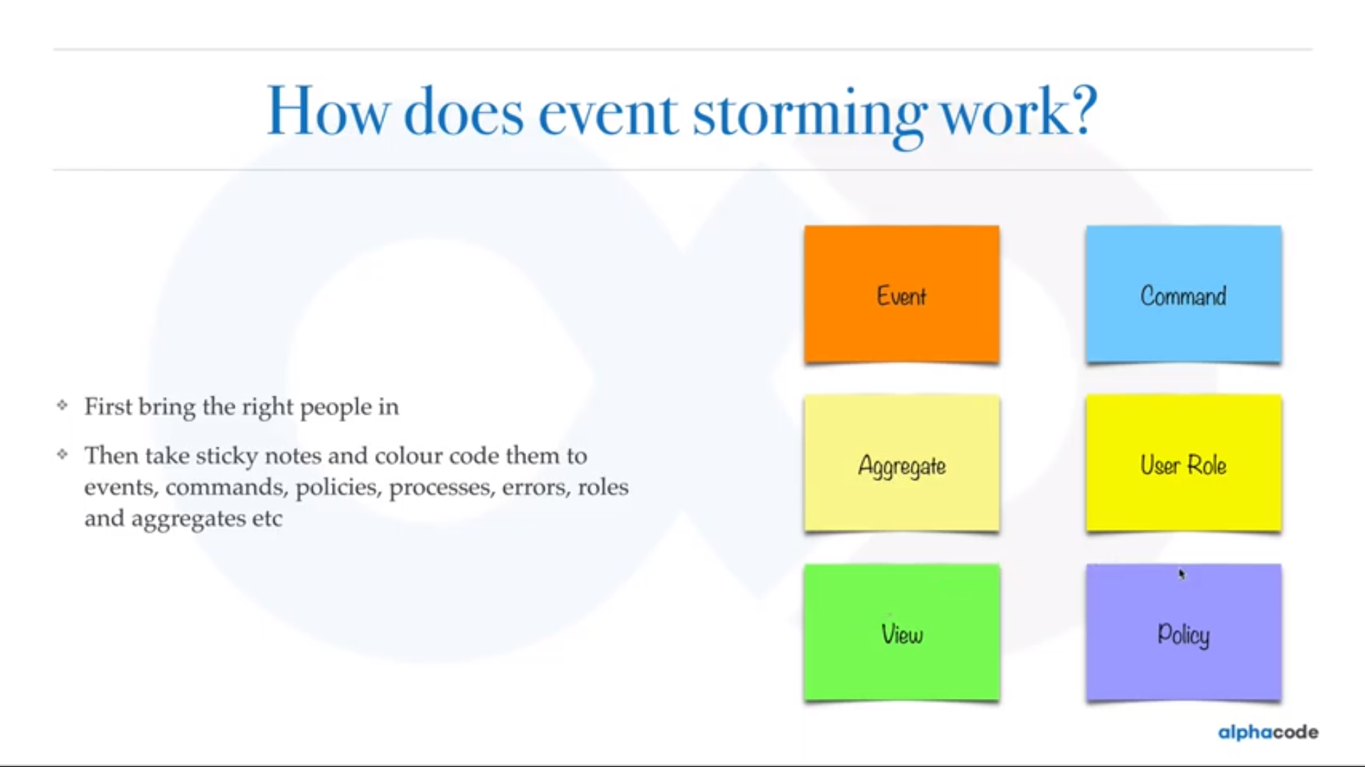

Slide 52
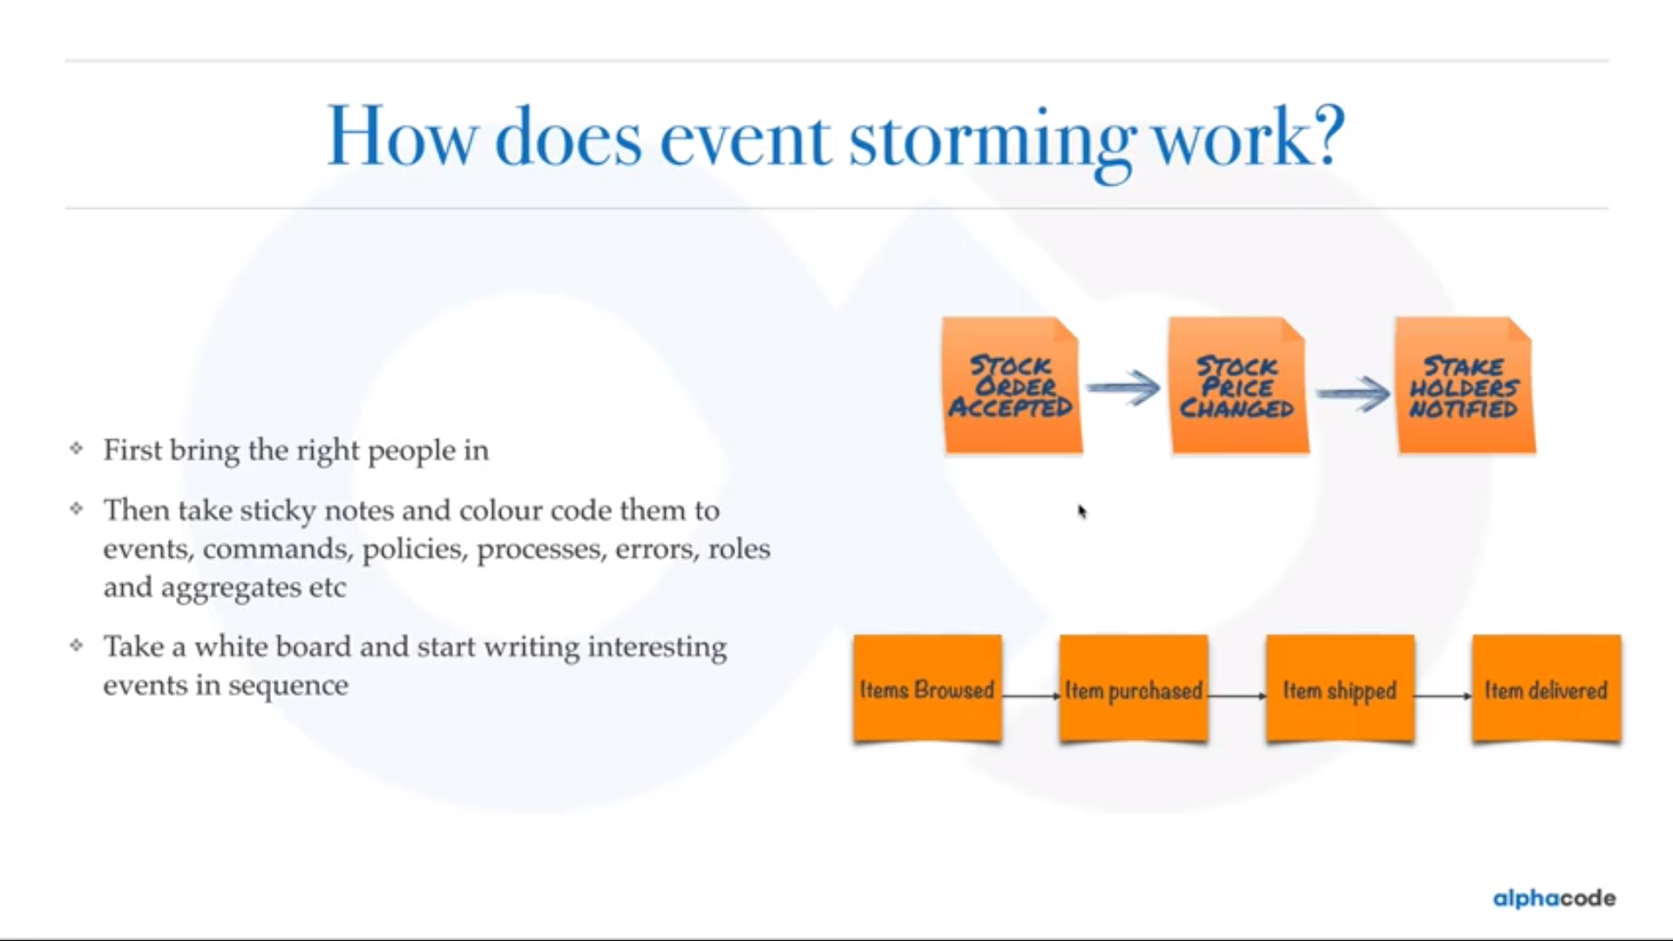

Slide 53
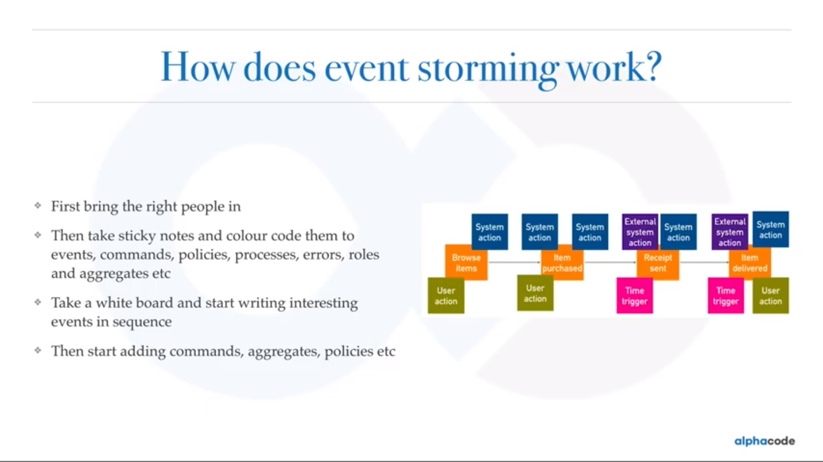

Slide 54
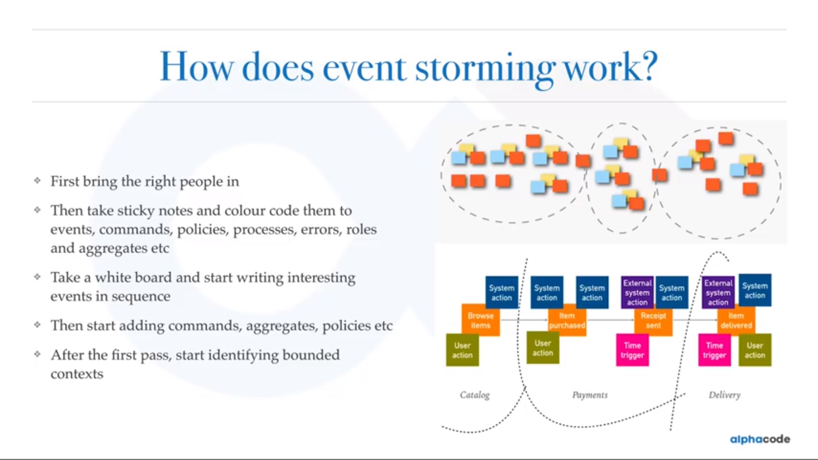

Slide 55
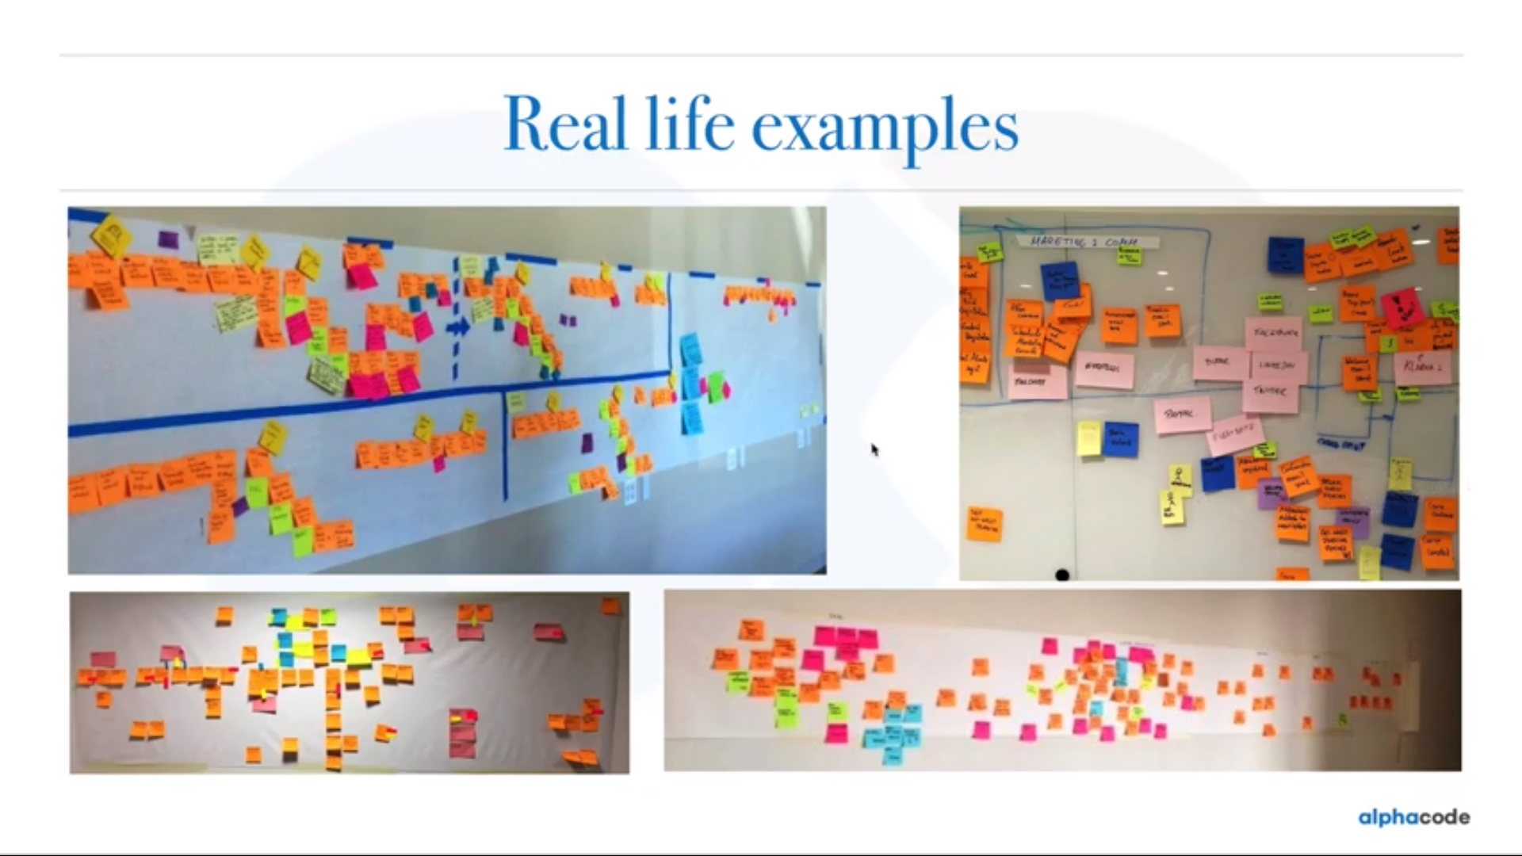

Slide 56
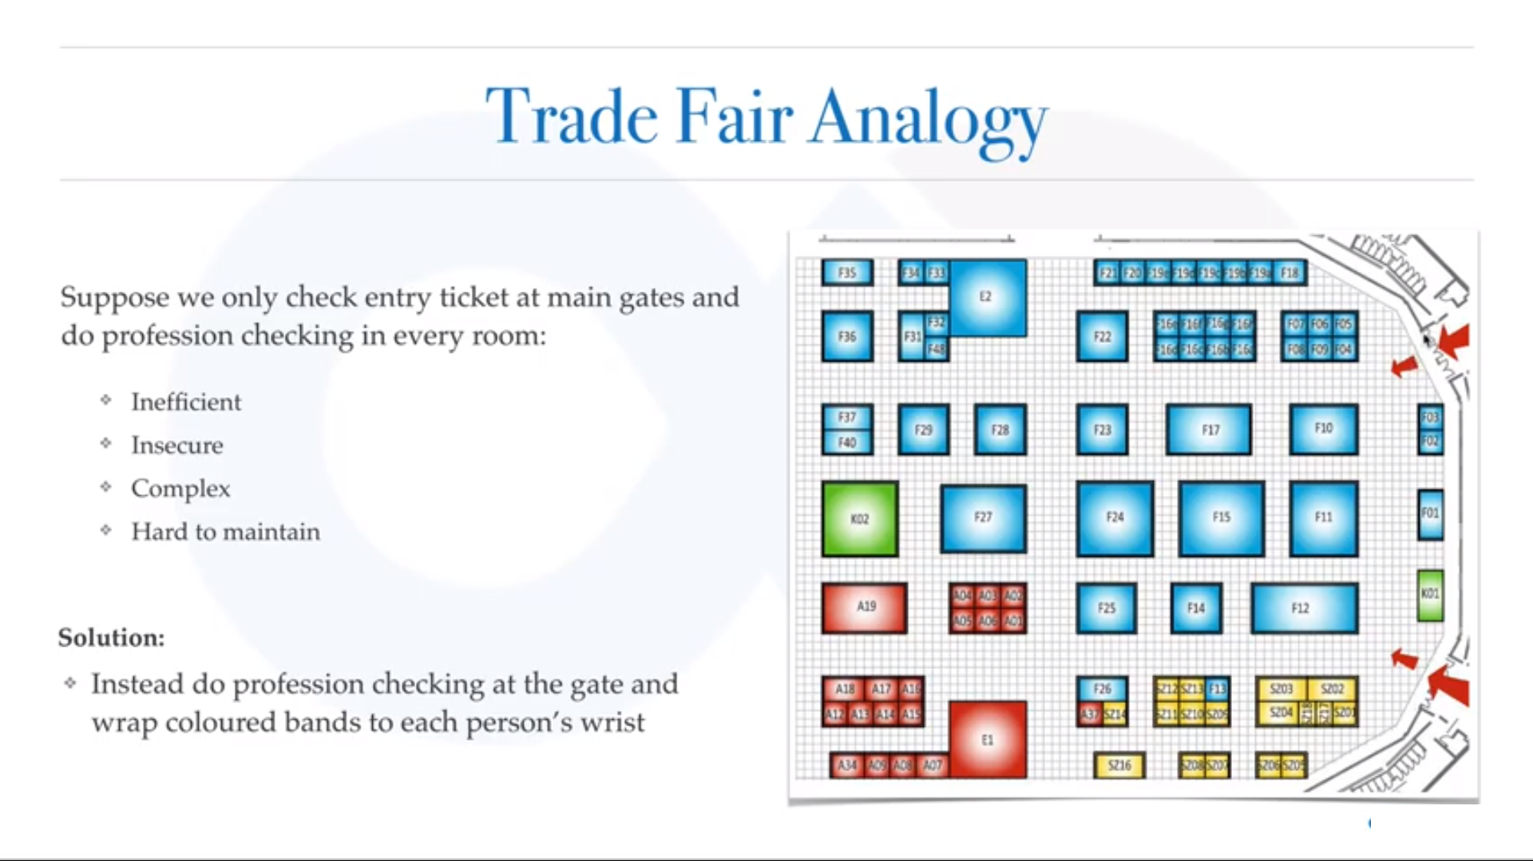

Slide 57


Slide 58


Slide 59


Slide 60


Slide 61


Slide 62


Slide 63


Slide 64


Slide 65
Problem Space
DDD emphasizes the need to focus on the business problem domain: its terminology, the core reasons behind why the software is being developed, and what success means to the business.
The need for the development team to value domain knowledge just as much as technical expertise is vital to gain a deeper insight into the problem domain and to decompose large domains into smaller subdomains.

Slide 66
Problem Space

Slide 67


Slide 68
Domain Expert
Domain Expert :The domain expert is the person who has the knowledge of the system or domain for which the software has to be developed .
They would require a product that will help them work on their projects better and hence they require Software Developers

Slide 69
Developer
Developer : The developer is responsible to take in requirements from the Domain Expert and model a software according to their needs.

Slide 70
Domain Expert and Developer
Domain experts and the developers together are equally responsible towards a final product when using the Domain Driven Design ideology

Slide 71


Slide 72


Slide 73
Domain Driven Design
The Solution Space
When you have a sound understanding of the problem domain, strategic patterns of DDD can help you implement a technical solution in synergy with the problem space.
Patterns enable core parts of your system that are crucial to the success of the product to be protected from the generic areas.

Slide 74
Solution Space
Core parts of your product that are sufficiently complex or will frequently change should be based on a model.
The tactical patterns of DDD along with Model-Driven Design will help you create a useful model of your domain in code.
A model is the home to all of the domain logic that enables your application to fulfill business use cases.
A model is kept separate from technical complexities to enable business rules and policies to evolve.
A model that is in synergy with the problem domain will enable your software to be adaptable and understood by other developers

Slide 75
Solution Space

Slide 76

The phrase ubiquitous language was first coined in Domain-Driven Design by Eric Evans.
It’s “the practice of building up a common, rigorous language between developers and users.”
A ubiquitous language is your team’s first line of defense against miscommunications.

Slide 77


Slide 78


Slide 79


Slide 80


Slide 81
Domain Driven Design
Domain‐Driven Design (DDD) is a development philosophy defined by Eric Evans in his seminal work Domain‐Driven Design: Tackling Complexity in the Heart of Software.
DDD is an approach to software development that enables teams to effectively manage the construction and maintenance of software for complex problem domains.

Slide 82
THE CHALLENGES OF CREATING SOFTWARE FOR COMPLEX PROBLEM DOMAINS
To understand how DDD can help with the design of software for a nontrivial domain, you must first understand the difficulties of creating and maintaining software.
By far, the most popular software architectural design pattern for business applications is the Big Ball of Mud (BBoM) pattern.
The definition of BBoM, as defined by Brian Foote and Joseph Yoder in the paper “Big Ball of Mud,” is “… a haphazardly structured, spreading, untidy code jungle.”

Slide 83
THE CHALLENGES OF CREATING SOFTWARE FOR COMPLEX PROBLEM DOMAINS
The issue with allowing software to dissolve into a BBoM becomes apparent when routine changes in workflow and small feature enhancements become a challenge to implement due to the difficulties in reading and understanding the existing codebase.
Eric Evans describes such systems as containing “code that does something useful, but without explaining how.”
One of the main reasons software becomes complex and difficult to manage is due to the mixing of domain complexities with technical complexities

Slide 84
Complexity in Software

Slide 85
WHAT IS AN ANALYSIS MODEL?
An analysis model is used to describe the logical design and structure of a software application.
It can be represented as sketches or by using modeling languages such as UML.
It is the representation of software that non‐technical people can conceptualize in order to understand how software is constructed.

Slide 86
Code Created without a Common Language
A lack of focus on a shared language and knowledge of the problem domain results in a codebase that works but does not reveal the intent of the business.
This makes codebases difficult to read and maintain because translations between the analysis model and the code model can be costly and error prone.
Code without a binding to an analysis model that the business understands will degrade over time and is therefore more likely to result in an architecture that resembles the BBoM pattern.
Due to the cost of translation teams that do not utilize the rich vocabulary of the problem domain in code will decrease their chances of discovering new domain concepts when collaborating with business experts.

Slide 87
A Lack of Organization
The initial incarnation of a system that resembles BBoM is fast to produce and often a well‐rounded success.
But because there is little focus based on the design of an application around a model of the problem domain, subsequent enhancements are troublesome.
The codebase lacks the required synergy with the business behavior to make change manageable.
Complexities of the problem domain are often mixed with the accidental complexities of the technical solution.

Slide 88
A Lack of Organization

Slide 89
Problem Domain
A problem domain refers to the subject area for which you are building software.
DDD stresses the need to focus on the domain above anything else when working on creating software for large‐scale and complex business systems.
Experts in the problem domain work with the development team to focus on the areas of the domain that are useful to be able to produce valuable software.
For example, when writing software for the health industry to record patient treatment, it is not important to learn to become a doctor.
What is important to understand is the terminology of the health industry, how different departments view patients and care, what information doctors gather, and what they do with it.

Slide 90
A Lack of Focus on the Problem Domain
Software projects fail when you don’t understand the business domain you are working within well enough.
Typing is not the bottleneck for delivering a product; coding is the easy part of development.
Outside of non‐functional requirements creating and keeping a useful software model of the domain that can fulfill business-use cases is the difficult part.
However, the more you invest in understanding your business domain the better equipped you will be when you are trying to model it in software to solve its inherent business problems.

Slide 91
HOW THE PATTERNS OF DOMAIN‐DRIVEN DESIGN MANAGE COMPLEXITY
DDD deals with both the challenge of understanding a problem domain and creating a maintainable solution that is useful to solve problems within it.
It achieves this by utilizing a number of strategic and tactical patterns.

Slide 94
The Strategic Patterns of DDD
The strategic patterns of DDD distil the problem domain and shape the architecture of an application.

Slide 95


Slide 96
Distilling the Problem Domain to Reveal What Is Important
Development teams and domain experts use analysis patterns and knowledge crunching to distill large problem domains into more manageable subdomains.
This distillation reveals the core sub domain—the reason the software is being written.
The core domain is the driving force behind the product under development; it is the fundamental reason it is being built.
DDD emphasizes the need to focus effort and talent on the core subdomain(s) as this is the area that holds the most value and is key to the success of the application.

Slide 97
Distilling the Problem Domain to Reveal What Is Important

Slide 98
Distilling the Problem Domain to Reveal What Is Important
Discovering the core domain helps teams understand why they’re producing the software and what it means for the software to be successful to the business.
It is the appreciation for the business intent that will enable the development team to identify and invest its time in the most important parts of the system.
As the business evolves, so in turn must the software; it needs to be adaptable.
Investment in code quality for the key areas of an application will help it change with the business.
If key areas of the software are not in synergy with the business domain then, over time, it is likely that the design will rot and turn into a big ball of mud, resulting in hard‐to‐maintain software.

Slide 99
Creating a Model to Solve Domain Problems
In the solution space a software model is built for each subdomain to handle domain problems and to align the software with the business contours.
This model is not a model of real life but more an abstraction built to satisfy the requirements of business use cases while still retaining the rules and logic of the business domain.
The development team should focus as much energy and effort on the model and domain logic as it does on the pure technical aspects of the application.
To avoid accidental technical complexity the model is kept isolated from infrastructure code.

Slide 100
Creating a Model to Solve Domain Problems
In the solution space a software model is built for each subdomain to handle domain problems and to align the software with the business contours.
This model is not a model of real life but more an abstraction built to satisfy the requirements of business use cases while still retaining the rules and logic of the business domain.
The development team should focus as much energy and effort on the model and domain logic as it does on the pure technical aspects of the application.
To avoid accidental technical complexity the model is kept isolated from infrastructure code.

Slide 101
Creating a Model to Solve Domain Problems
All models are not created equal; the most appropriate design patterns are used based on the complexity needs of each subdomain rather than applying a blanket design to the whole system.
Models for subdomains that are not core to the success of the product or that are not as complex need not be based on rich object‐oriented designs and can instead utilize more procedural or data‐driven architectures..

Slide 102
Using a Shared Language to Enable Modeling Collaboration
Models are built through the collaboration of domain experts and the development team.
Communication is achieved using an ever‐evolving shared language known as the ubiquitous language (UL) to efficiently and effectively connect a software model to a conceptual analysis model.
The software model is bound to the analysis model by using the same terms of the UL for its structure and class design.

Slide 103
Isolate Models from Ambiguity and Corruption
Models sit within a bounded context, which defines the applicability of the model and ensures that its integrity is retained.
Larger models can be split into smaller models and defined within separate bounded contexts where ambiguity in terminology exists or where multiple teams are a working in order to further reduce complexity.

Slide 104
Applying the strategic patterns of Domain‐Driven Design.

Slide 105
Understanding the Relationships between Contexts
DDD understands the need to ensure that teams and the business are clear on how separate models and contexts work together in order to solve domain problems that span across subdomains.
Context maps help you to understand the bigger picture; they enable teams to understand what models exist, what they are responsible for, and where their applicability boundaries are.
These maps reveal how different models interact and what data they exchange to fulfill business processes.
The relationships between the connections and more importantly the grey area of process that sits between them is often not captured or well understood by the business.

Slide 106
Stake Holders vs Domain Experts

Slide 107
THE PRACTICES AND PRINCIPLES OF DOMAIN‐DRIVEN DESIGN

Slide 108
Focusing on the Core Domain
DDD stresses the need to focus the most effort on the core subdomain.
The core subdomain is the area of your product that will be the difference between it being a success and it being a failure.
It’s the product’s unique selling point, the reason it is being built rather than bought.
The core domain is the area of the product that will give you a competitive advantage and generate real value for your business.
It is vital that all of the team understand what the core domain is.

Slide 109
Learning through Collaboration
DDD stresses the importance of collaboration between the development teams and business experts to produce useful models to solve problems.
Without this collaboration and commitment from the business experts, much of the knowledge sharing will not be able to take place, and development teams will not gain deeper insights into the problem domain.
It is also true that through collaboration and knowledge crunching, the business has the opportunity to learn much more about its domain.

Slide 110
Creating Models through Exploration and Experimentation
DDD treats the analysis and code models as one.
This means that the technical code model is bound to the analysis model through the shared UL.
A breakthrough in the analysis model results in a change to the code model.
A refactoring in the code model that reveals deeper insight is again reflected in the analysis model and mental models of the business.
Breakthroughs only occur when teams are given time to explore a model and experiment with its design.
Spending time prototyping and experimenting can go a long way in helping you shape a better design.
It can also reveal what a poor design looks like.
Eric Evans suggests that for every good design there must be at least three bad ones, this will prevent teams stopping at the first useful model.

Slide 111
Communication
The ability to effectively describe a model built to represent a problem domain is the foundation of DDD.
This is why, without a doubt, the single most important facet of DDD is the creation of the UL.
Without a shared language, collaboration between the business and development teams to solve problems would not be effective.
Analysis and mental models produced in knowledge‐crunching sessions between the teams need a shared language to bind them to a technical implementation.
Without an effective way to communicate ideas and solutions within a problem domain, design breakthroughs cannot occur.

Slide 112
Understanding the Applicability of a Model
Each model that is built is understood within the context of its subdomain and described using the UL.
However, in many large models, there can be ambiguity within the UL, with different parts of an organization having different understandings of a common term or concept.
DDD addresses this by ensuring that each model has its own UL that is valid only in a certain context.
Each context defines a linguistic boundary; ensuring models are understood in a specific context to avoid ambiguity in language.
Therefore a model with overlapping terms is divided into two models, each clearly defined within its own context.
On the implementation side, strategic patterns can enforce these linguistic boundaries to enable models to evolve in isolation.
These strategic patterns result in organized code that is able to support change and rewriting.

Slide 113
Constantly Evolving the Model
Any developer working on a complex system can write good code and maintain it for a short while.
However, without synergy between the source code and the problem domain, continued development will likely end up in a codebase that is hard to modify, resulting in a BBoM.
DDD helps with this issue by placing emphasis on the team to continually look at how useful the model is for the current problem.
It challenges the team to evolve and simplify complex models of domains as and when it gains domain insights.
DDD is still no silver bullet and requires dedication and constant knowledge crunching to produce software that is maintainable for years and not just months.
New business cases may break a previously useful model, or may necessitate changes to make new or existing concepts more explicit.

Slide 114
POPULAR MISCONCEPTIONS OF DOMAIN‐DRIVEN DESIGN
Tactical Patterns Are Key to DDD
DDD Is a Framework
DDD Is a Silver Bullet

Slide 115
THE SALIENT POINTS
Domain‐Driven Design (DDD) is a development philosophy that is designed to manage the creation and maintenance of software written for complex problem domains.
DDD is a collection of patterns, principles, and practices, which can be applied to software design to manage complexity.
DDD has two types of patterns.
Strategic patterns shape the solution, while tactical patterns are used to implement a rich domain model.
Strategic patterns can be useful for any application but tactical patterns are only useful if your model is sufficiently rich in domain logic.

Slide 116
THE SALIENT POINTS
Distillation of large problem domains into subdomains can reveal the core domain—the area of most value.
Not all parts of a system will be well designed; teams must invest more time in the core subdomain(s) of a product.
An abstract model is created for each subdomain to manage domain problems.
A ubiquitous language is used to bind the analysis model to the code model in order for the development team and domain experts to collaborate on the design of a model.
Learning and creating a language to communicate about the problem domain is the process of DDD.

Slide 117
THE SALIENT POINTS
Code is the artifact.
In order to retain the integrity of a model, it is defined within a bounded context.
The model is isolated from infrastructure concerns of the application to separate technical complexities from business complexities.
Where there is ambiguity in terminology for a model or multiple teams at work the model can be split and defined in smaller bounded contexts.
DDD does not dictate any specific architectural style for development, it only ensures that the model is kept isolated from technical complexities so that it can focus on domain logic concerns.

Slide 118
THE SALIENT POINTS
DDD values a focus on the core domain, collaboration, and exploration with domain experts, experimentation to produce a more useful model, and an understanding of the various contexts in play in a complex problem domain.
DDD is not a patterns language, it is a collaboration philosophy focused on delivery, with communication playing a central role.
DDD is a language‐ and domain‐centric approach to software development.

Slide 120
HOW TO FOCUS ON THE CORE PROBLEM

Slide 121
Distilling a Problem Domain

Slide 122
The domain of an online auction site distilled into subdomains

Slide 123
The distilled domain of an online auction site partitioned into core, generic, and supporting domains

Slide 124
How a solution maps to the subdomains of the auction system.

Slide 125
The role of a domain model

Slide 126
Model Driven Design
A model driven design is a code or software built around a set of domain concepts extracted from the domain experts.
Hence right from the start the implementation and domain are dependent on each other thus creating a feedback loop which unlike the waterfall model will be very useful .
Model Change ➔Code Change and likewise
Code Change ➔ Model Change

Slide 127
The domain versus the domain model

Slide 128
The binding between the code and analysis model

Slide 129
how the analysis and code models can diverge from each other if the development team is not involved in domain knowledge crunching

Slide 130
The code model and the analysis model are kept in synergy

Slide 131
Team modeling

Slide 132
Translation costs of the project

Slide 133
THE DOMAIN LAYER

Slide 134
Domain Model Pattern

Slide 135
Questions

Slide 136
Module Summary
Spring Integration Framework.
Message, Channel and Adapter
Understood the different Component Integration
Understood the Event-Driven Architecture

